Slide 1
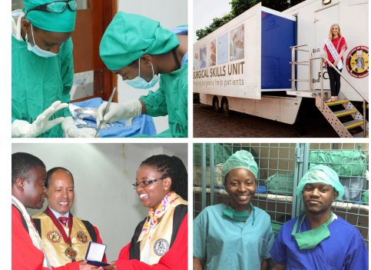


The RCSI / COSECSA Collaboration Programme
ESTHER Alliance, November 2016,
Eric O’Flynn

Slide 2
The Problem
5 billion people worldwide (including 93% of people in Sub-Saharan Africa) lack access to safe, affordable, timely surgical care.

Slide 3
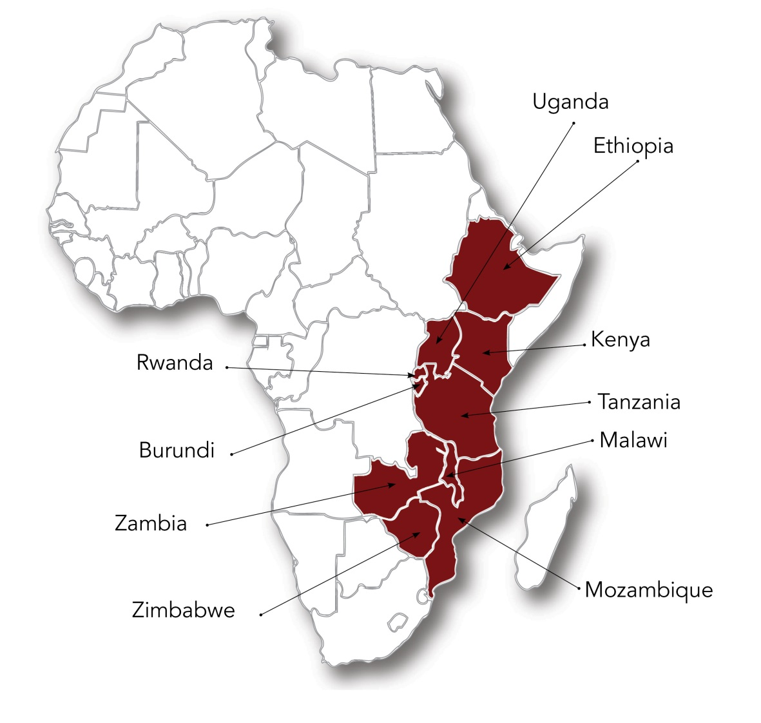
College of Surgeons of East, Central and Southern Africa (COSECSA)
  Surgcial training - seven specialities and sub-specialties
  Over 400 surgical trainees in 62 training locations.
  Since 2004, 158 specialist surgeons have graduated.

Slide 4
RCSI/COSECSA Collaboration Programme Rationale
Local organisations, local qualifications
Ability to scale up training
RCSI/COSECSA Collaboration supports all aspects of rapid scale up

Slide 5
The RCSI/COSECSA Collaboration
A cross–college collaboration since 2007 with a wide range of activities
involving a large number of RCSI staff and fellows.
Funded by Irish Aid with a significant in-kind contribution from RCSI.
Overseen by a steering committee made up of Irish-based and African-
based committee members.

Slide 6
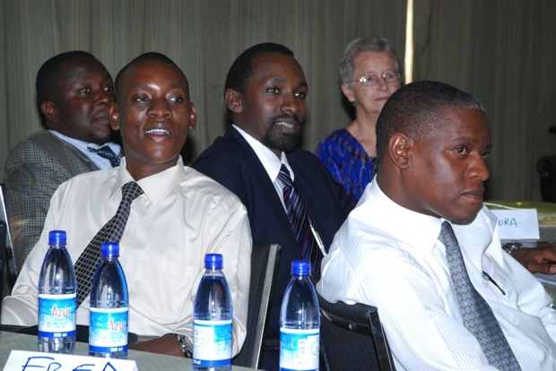
Training
Train the Trainer courses for all
COSECSA trainers
Over 300 surgeons trained (as well as 28 Master Trainers).
Basic Science Faculty development
27 surgeon basic scientists completed
three-year training programme and are
now delivering courses.

Slide 7
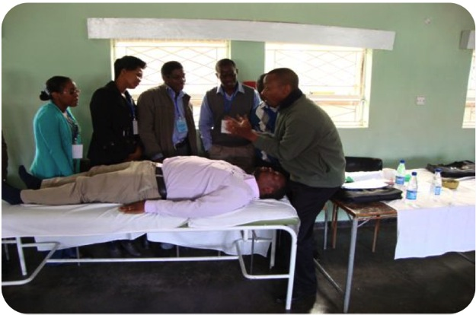
Training
Fellowship level seminars
14 seminars held in orthopaedic
surgery and general surgery
Essential Surgical Training
Training rural doctors in Zimbabwe,
Rwanda and Zambia in basic surgical
techniques.

Slide 8
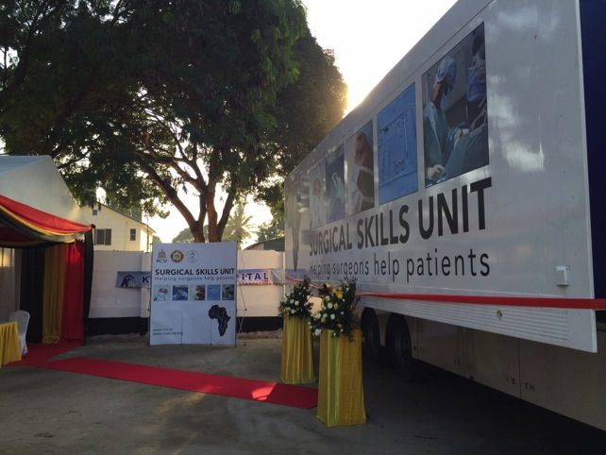
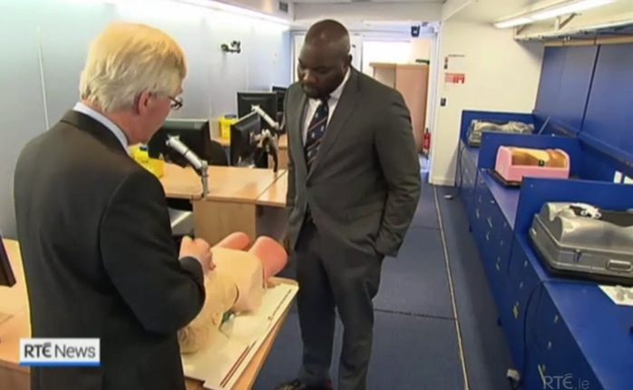
Training
Mobile Surgical Skills Unit
The world’s only mobile surgical skills training unit, operating in a pilot project in Kenya and Tanzania.

Slide 9
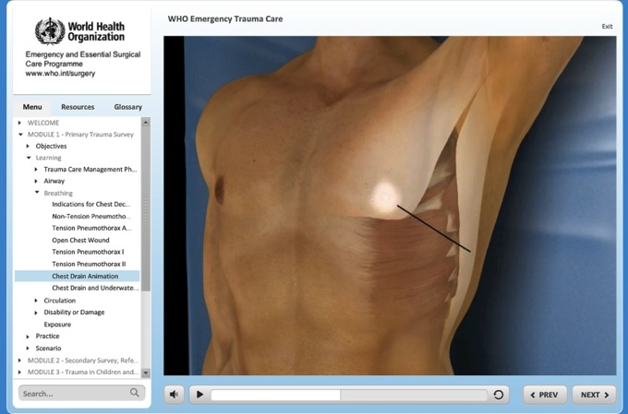
E- Learning
Joint development and admin of an
Africa-centric surgical e-learning
platform.
26 IT labs equipped and supported
In 10 countries.
Production of WHO Emergency and
Trauma Care E-Learning Package

Slide 10
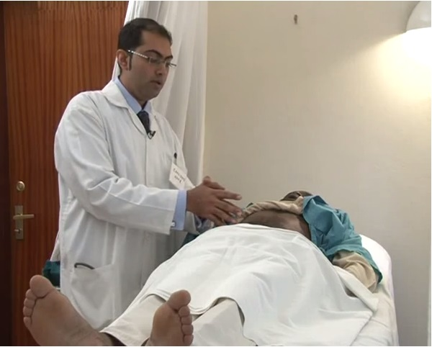
Examinations
Two-way exchange of examiners
and external examiners.
Benchmarking of COSECSA exams
against RCSI exams.
Collaboration on delivery of pre-
exam seminar, MCQ writing
seminar, exam explanation videos,
implementation of OSCE format.

Slide 11
Administration
  Assistance in promotion of COSECSA regionally and
  internationally, development of website and materials.
  Support for recruitment and cost of staffing in COSECSA
  Secretariat in Tanzania.
  Budgetary support, strategic planning, financial management.

Slide 12
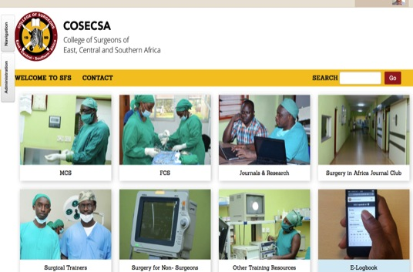
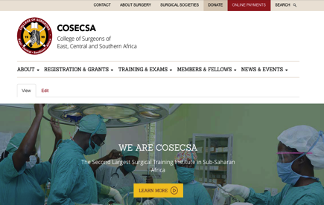
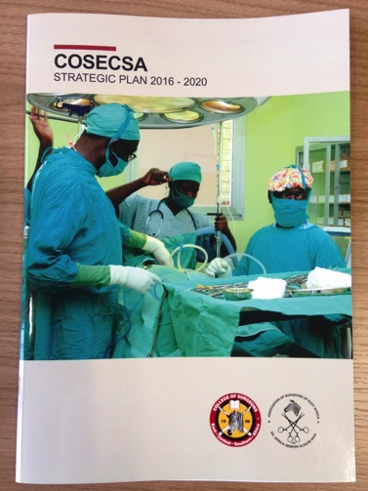
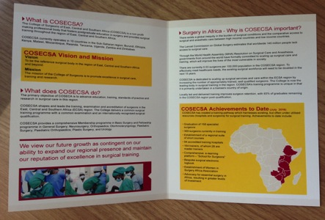
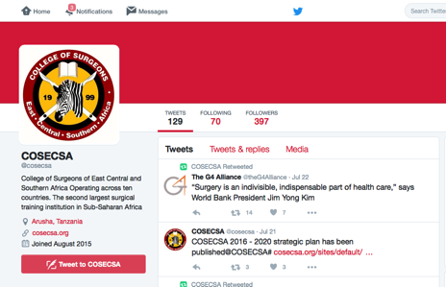
Administration

Slide 13
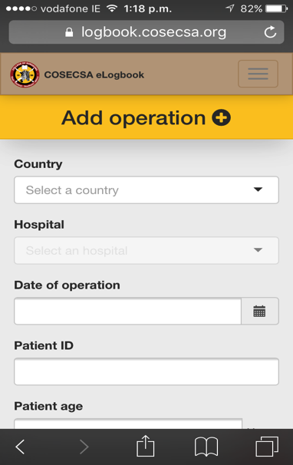
Data
  Through the Collaboration Programme COSECSA now has:
  Details of every surgeon in all 10 countries of the region
  Mapping of international interventions in the region
  Bespoke electronic logbook

Slide 14
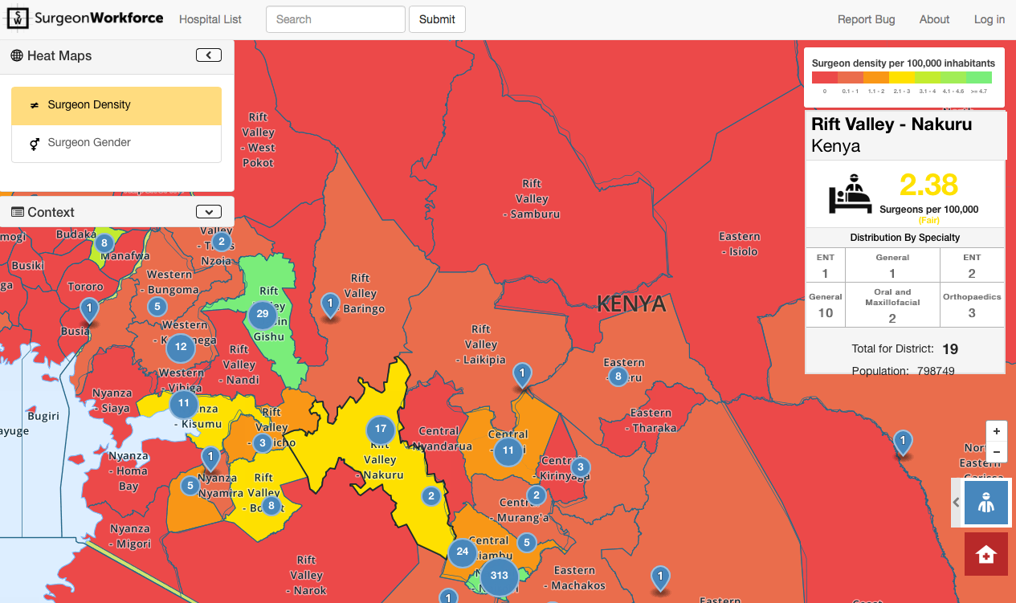
Data

Slide 15
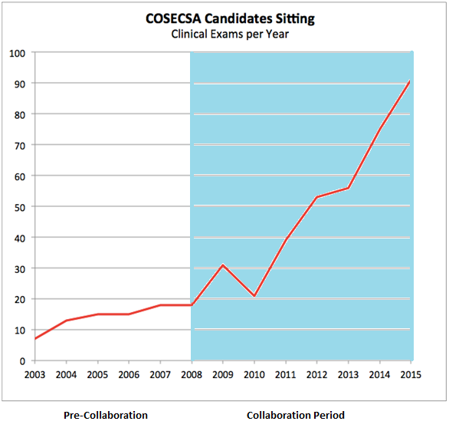
Progress
Notes:
These are the numbers sitting Clinical and Viva exams.
To sit, candidates must have already passed the written exams

Slide 16
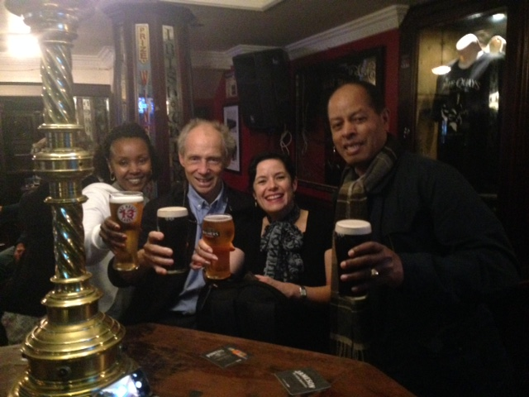
The Key To Successful Partnership
Notes:
The “Paris Declaration on Aid Effectiveness” is a set of best practise principles in international aid. This page is a lighly

Slide 17
What Doesn’t Work
When it becomes “someone’s project”
Creates significant new demands on existing staff on either side
Innovation or equipment without capacity building
Unclear lines of responsibility

Slide 18
What Does Work
Institutional, not personal
Project helps the Southern institution meet their own targets
Non-clinical cooperation
Dedicated staff
“50-50” representation in governance structures

Slide 19
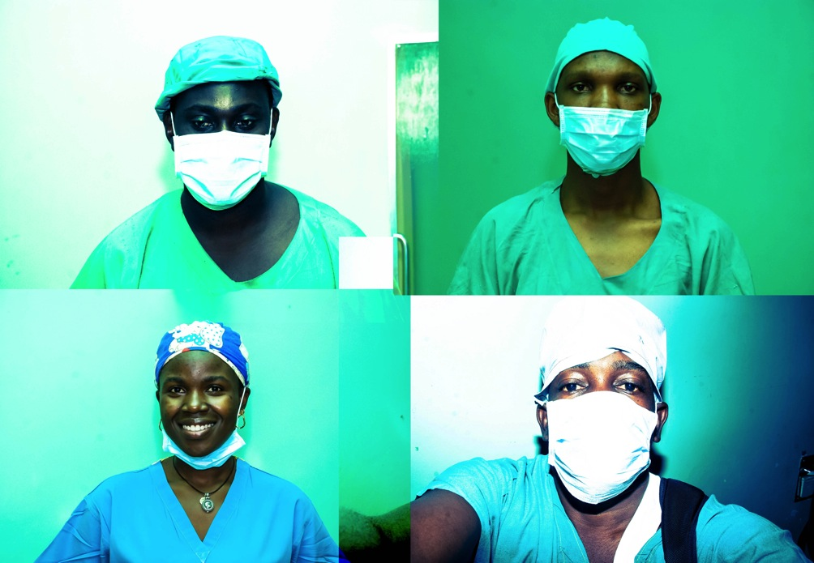
Thank You!

