Slide 1


Ministry of Health Moz & HSE Ireland
Partnership
Elenia Macamo Amado
MD, OB/GY
National Deputy Director
Medical Assistance

Slide 2
Summary
Introduction
Overview of the partnership
Description of the kind of partnership
The model of partnership
Achievements
Future plans

Slide 3
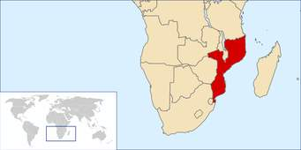
Introduction
25 million habitants
Coastal Land 3000 km
Maternal deaths 408/100.000
Neonatal deaths 64/1000
Prevalence HIV 11.5%
Life expectancy 53 years
Health coverage 60%
Infectious diseases (Malaria, TB)

Slide 4
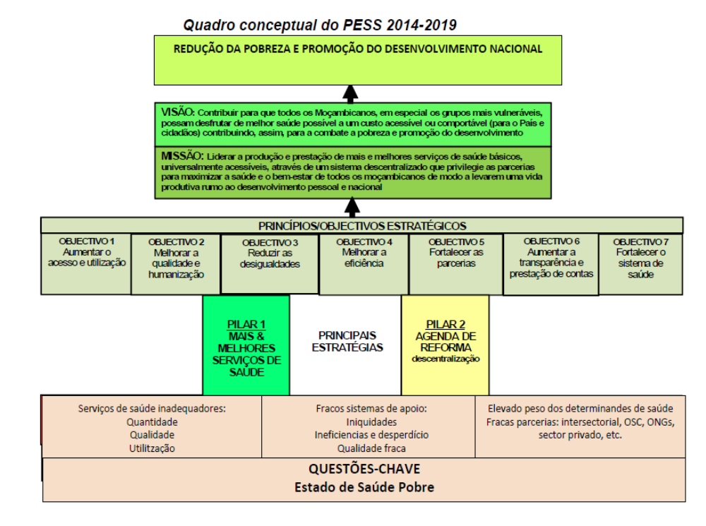
Introduction

Slide 5
Health Facilities Network
7
4
5
8
7
4
8
Total | 1537
District Hospitals | 44
Urban Health Centers | 1217
Sub Urban Health Centers | 106
Health Posts | 107
5
5
4
5

Slide 6
Quality/Humanization Program
Washing hands Initiative
Infection and Prevention control program
Model In-Patient services
Model Maternities
FOGELA
Clinical analyses of medical and nurses records
Manchester Std. on Emergency services
Pharmacy Management Clerk

Slide 7
Overview of the partnership
June 2014 MOU between Ireland embassy/ HSE and Mozambique
September 2014: Team from Mozambique visit Ireland
August 2015: HSE team visit Mozambique
  Initiated partnerships to improve Quality and Safety through Workshops (Building Knowledge – Theory of Knowledge)
Two Workshop in August and November 2016 (17 projects for each Hospital and some Ministry departments )

Slide 8
The model of partnership
Sharing of knowledge of different health systems
Coaching Conversations
Training team leaders
(Building Knowledge -Theory of Knowledge)
Improve quality with local resources

Slide 9
Achievements
On going 17 projects in 14 hospitals and 3 departments of Ministry of Health ( Mozambique)
in different areas (reduce waiting time in emergency services, improve medical and nursing records, reduce hospital mortality, improve patient and health care professionals good relationships, improve medical prescribing, improve referral system)

Slide 10
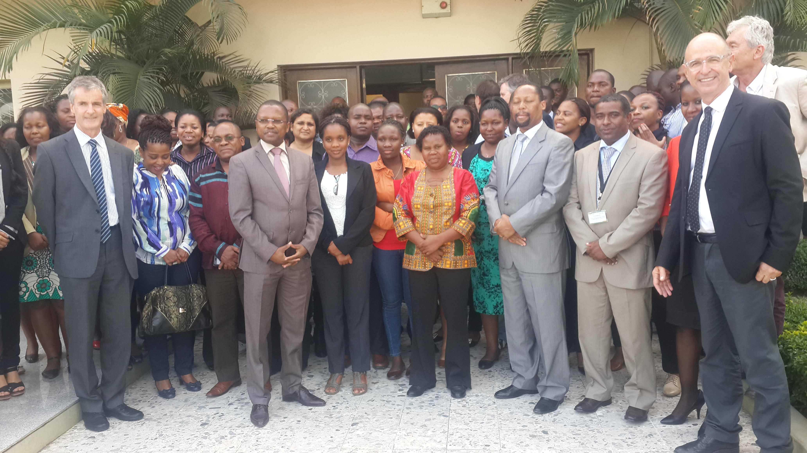

Slide 11
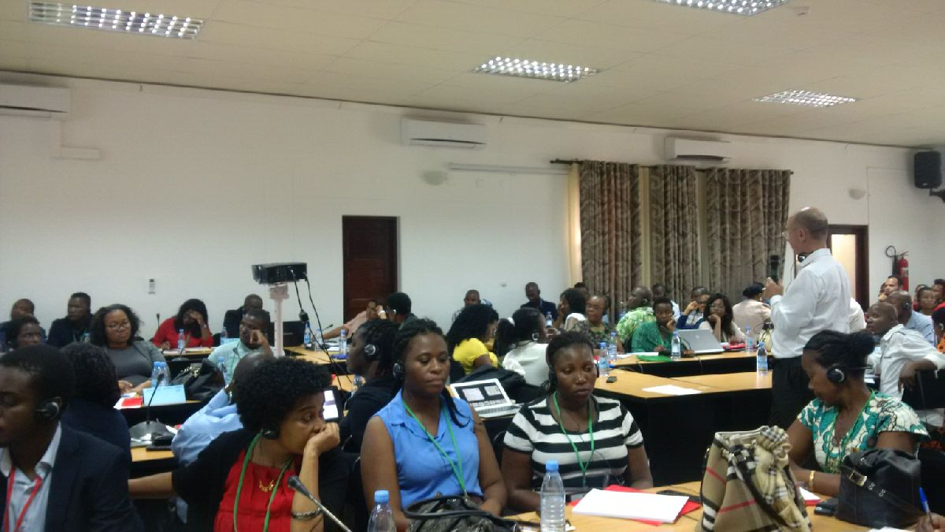
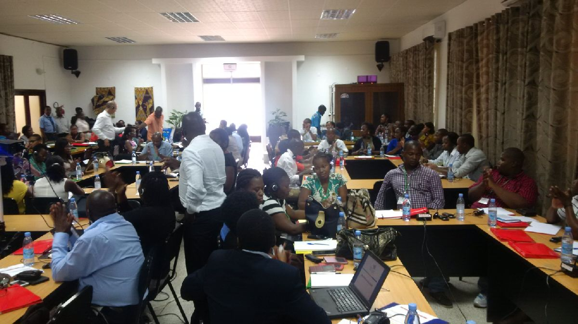
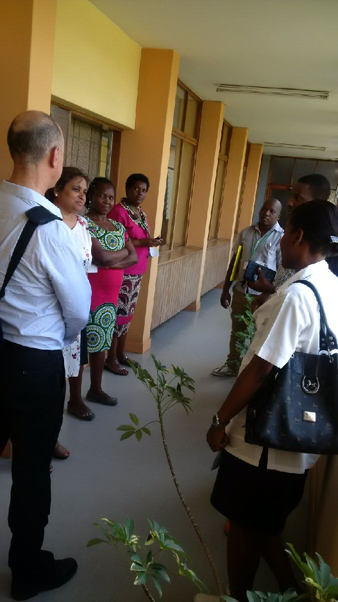
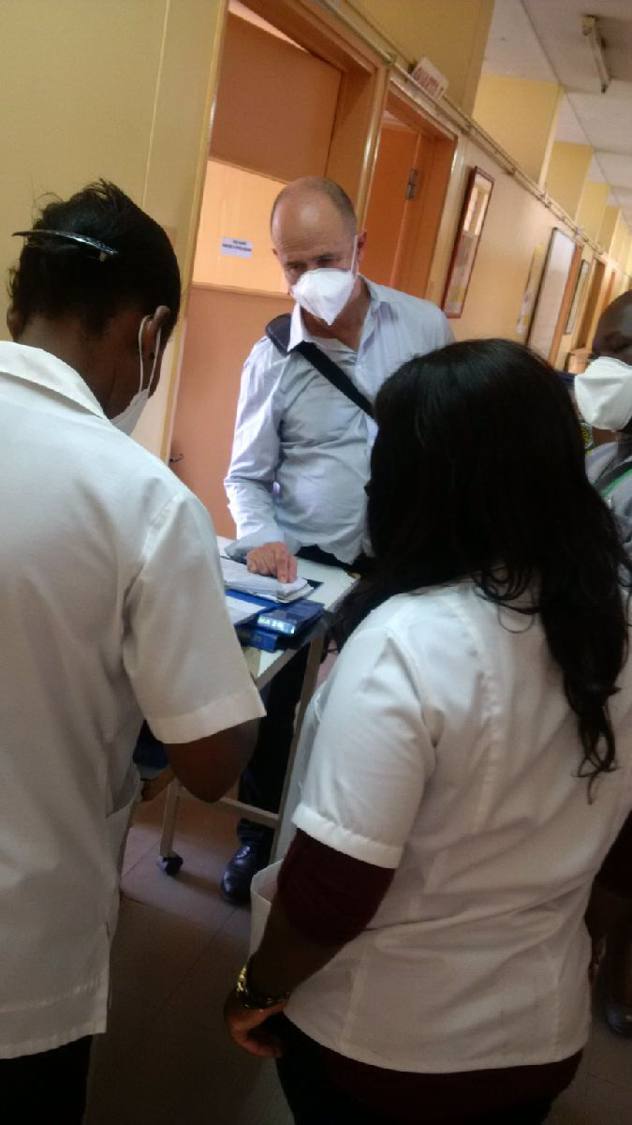

Slide 12
Constraints
Miles of distance ( 9553 km – 5936 miles)…
Communications (conference calls)

Slide 13
Future Plans
Twin hospital project
Extend this project to other Directorates ( Finance; Human Resources)
Framework for Improving Quality for Mozambique
Keep the Coaching Conversations
Video conference ( Skype)

Slide 14
Partnership
But one swallow does not make a summer, and this means it will be very difficult for you to move through parts of the scenario alone
Together we go further ……..

Slide 15

Our best velour is the life
THANK YOU

