Slide 1
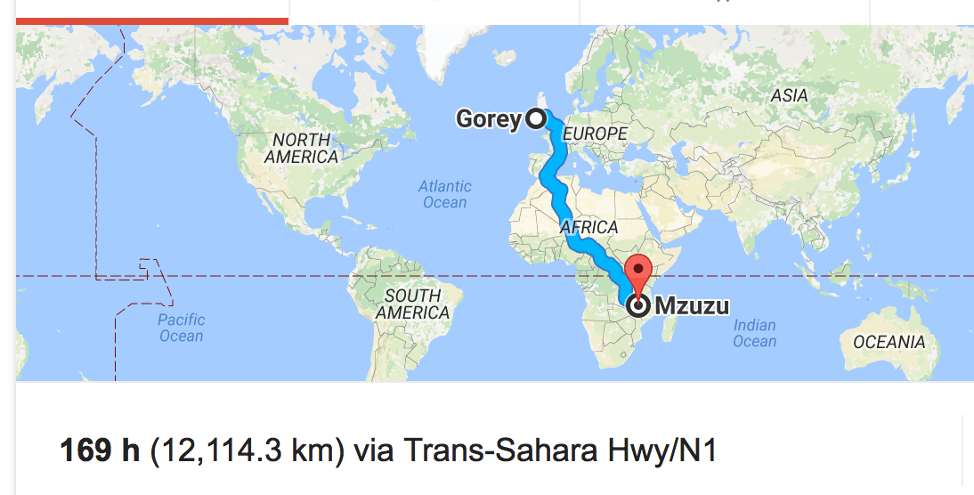

From Goppa Codes to Gorey
Adventures in partnership!
Mzuzu Central Hospital – The Palms GP Surgery

Slide 2
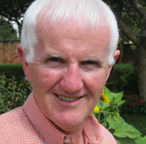
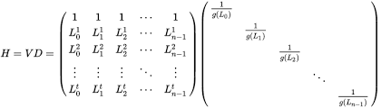
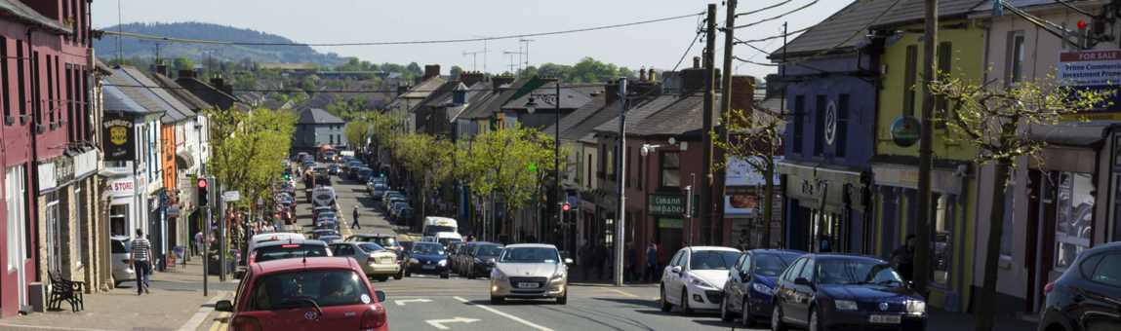
How it all started . . .

Slide 3
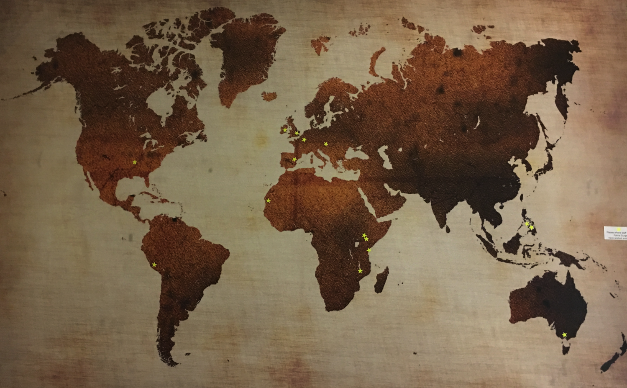
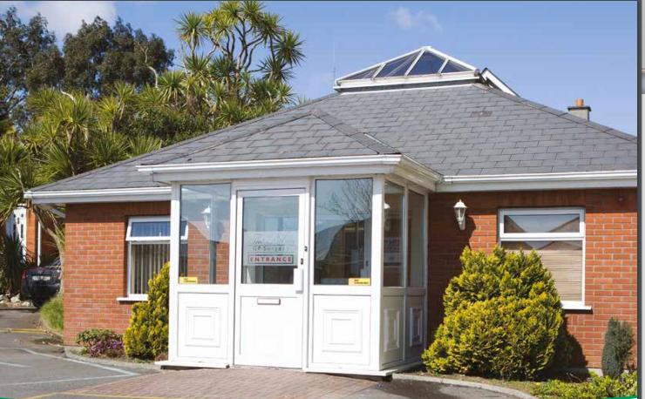
The Palms GP Surgery
Notes:
Eight doctors including a GP registrar,
Five nurses and 10 administration staff with a patient cohort of 14,000 patients and undertakes over 80,000 consultations each year in the practice. It hosts students from UCD, TCD, RCSI and UL and GP trainees from the South East GP training scheme who also have the opportunity to undertake a rotation in Malawi as part of the their training programme.

Slide 4
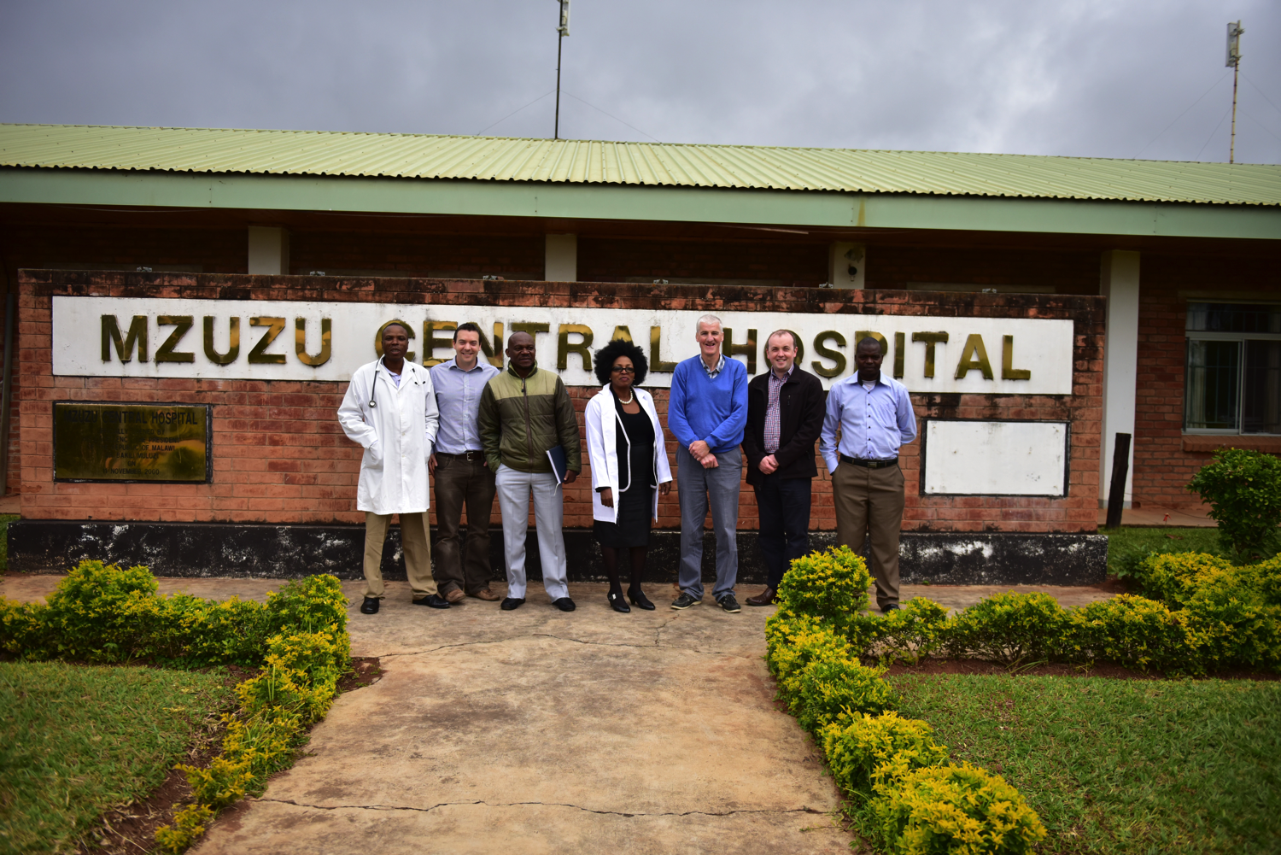

Slide 5

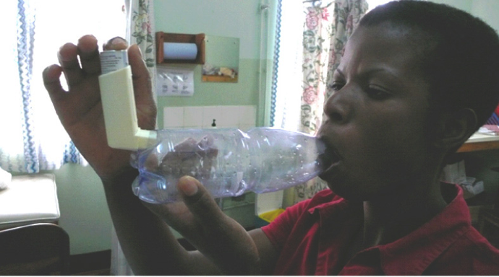
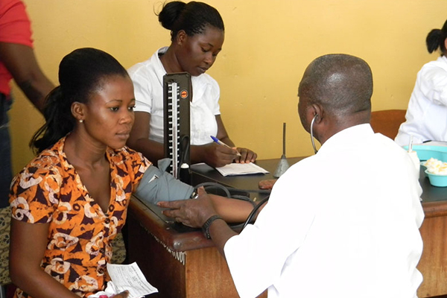
Non communicable diseases
Notes:
A STEPS survey conducted in Malawi in 2009 clearly demonstrates that NCDs and their risk factors are a significant public health problem. A total of 32.9% of individuals aged 25–64 years were hypertensive, while 8.9% suffered from cardiovascular diseases. Over 75% of those with hypertension were unaware that they were hypertensive. The prevalence of diabetes is estimated at 5.6%, which is similar to Irish prevalence.
Chronic respiratory diseases such as asthma are becoming a public health problem in Malawi. According to the World Health Report 2004, Malawi has an estimated asthma prevalence of 5.1%, yet there are no specific programmes for the prevention and control of asthma. Mental illness is also increasingly becoming a public health problem, accounting for 4% of the total burden of disease. Epilepsy has 2.8% prevalence rate with the age group which appear to have the highest incidence of epilepsy are those between 6-18 years

Slide 6


Slide 7
Local hospitals & clinics in Northern Region of Malawi
Luke International
Northern zone health office
Ungweru
The Palms GP Surgery
Mzuzu Central Hospital
Mzuzu University
University College Dublin
Ministry of Health Malawi
Queens University Belfast
Family Medicine Programme, Malawi
South East GP Training Programme

Slide 8
Advisory Group
The Palms GP Surgery
Mzuzu Central Hospital

Slide 9
12 month goals
Development of flowsheets/decision aids for NCDs
Development of Whatsapp and Skype groups to share learning in NCDs between Malawi and Ireland
Development of syllabus and structure of a Clinical Fellow in NCDs
Seeking of funding for fellowship
Memoradndum of Understanding between Mzuzu Central Hospital and Palms GP Surgery, Gorey
Formation of advisory group involving Malawi and Irish representatives

Slide 10
36 month goals
  Development of eHealth and electronic resources in collaboration with Irish & Malawi academic partners
  Expansion of partnership to other healthcare facilites in the Northern region and involvement of family medicine programme in Malawi with local Irish GP training support.
  Development of a structured NCD clinical fellow role who would spend a period of time in Ireland (1.5-3 months) followed by dedicated research and education time in Malawi for development of services

Slide 11
Lessons learned
Need to formalise partnerships for sustainability
Involve all colleagues
Consult widely but stay focused
Build on existing processes
Start with small projects

Slide 12
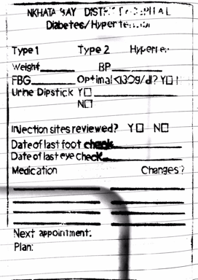
What have we learned?
Leading us to examine how we develop protocols and decision aids
Group education
Exchange visits of staff to Ireland & Malawi
Cultural awareness

Slide 13
Acknowledgements
ESTHER Ireland
Our colleagues in Malawi and Ireland who have enthusiastically supported the development of the partnership.

