Slide 1



TWIN 2 H

Slide 2
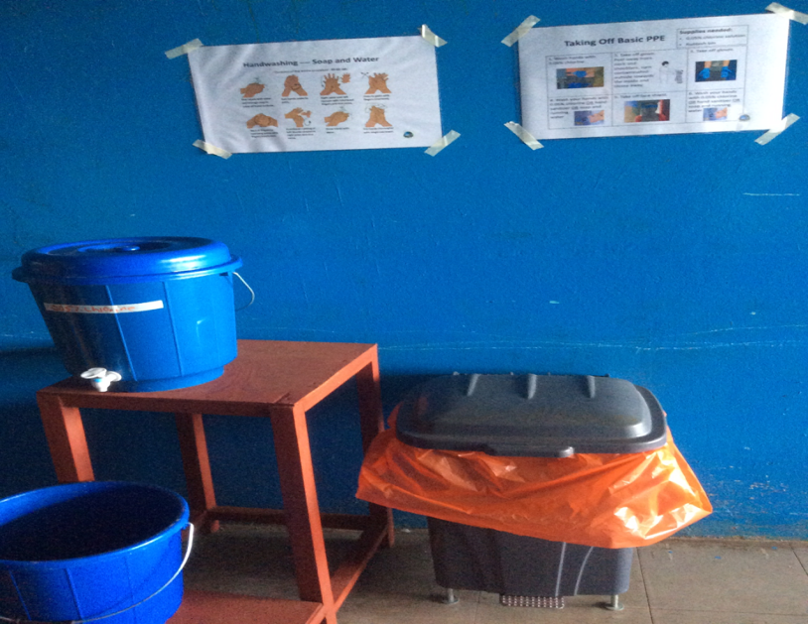

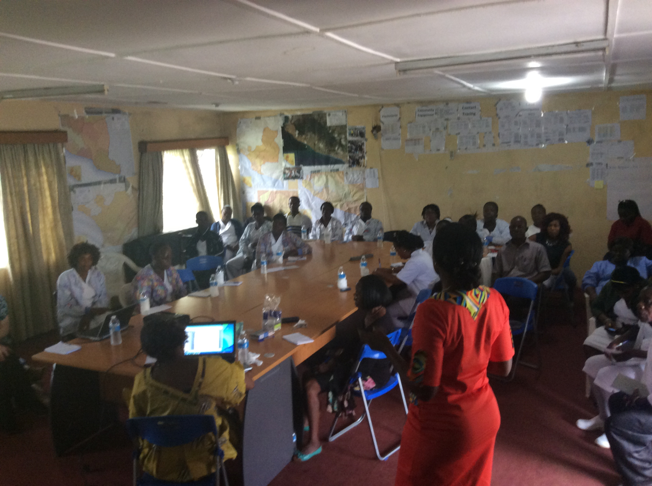
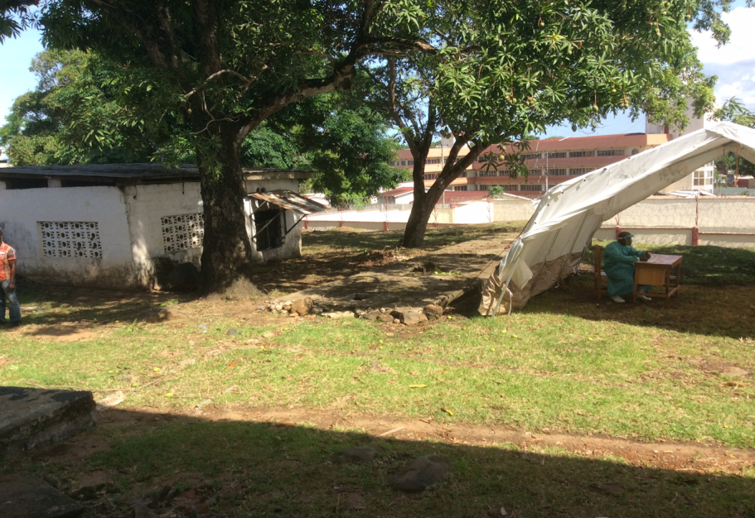
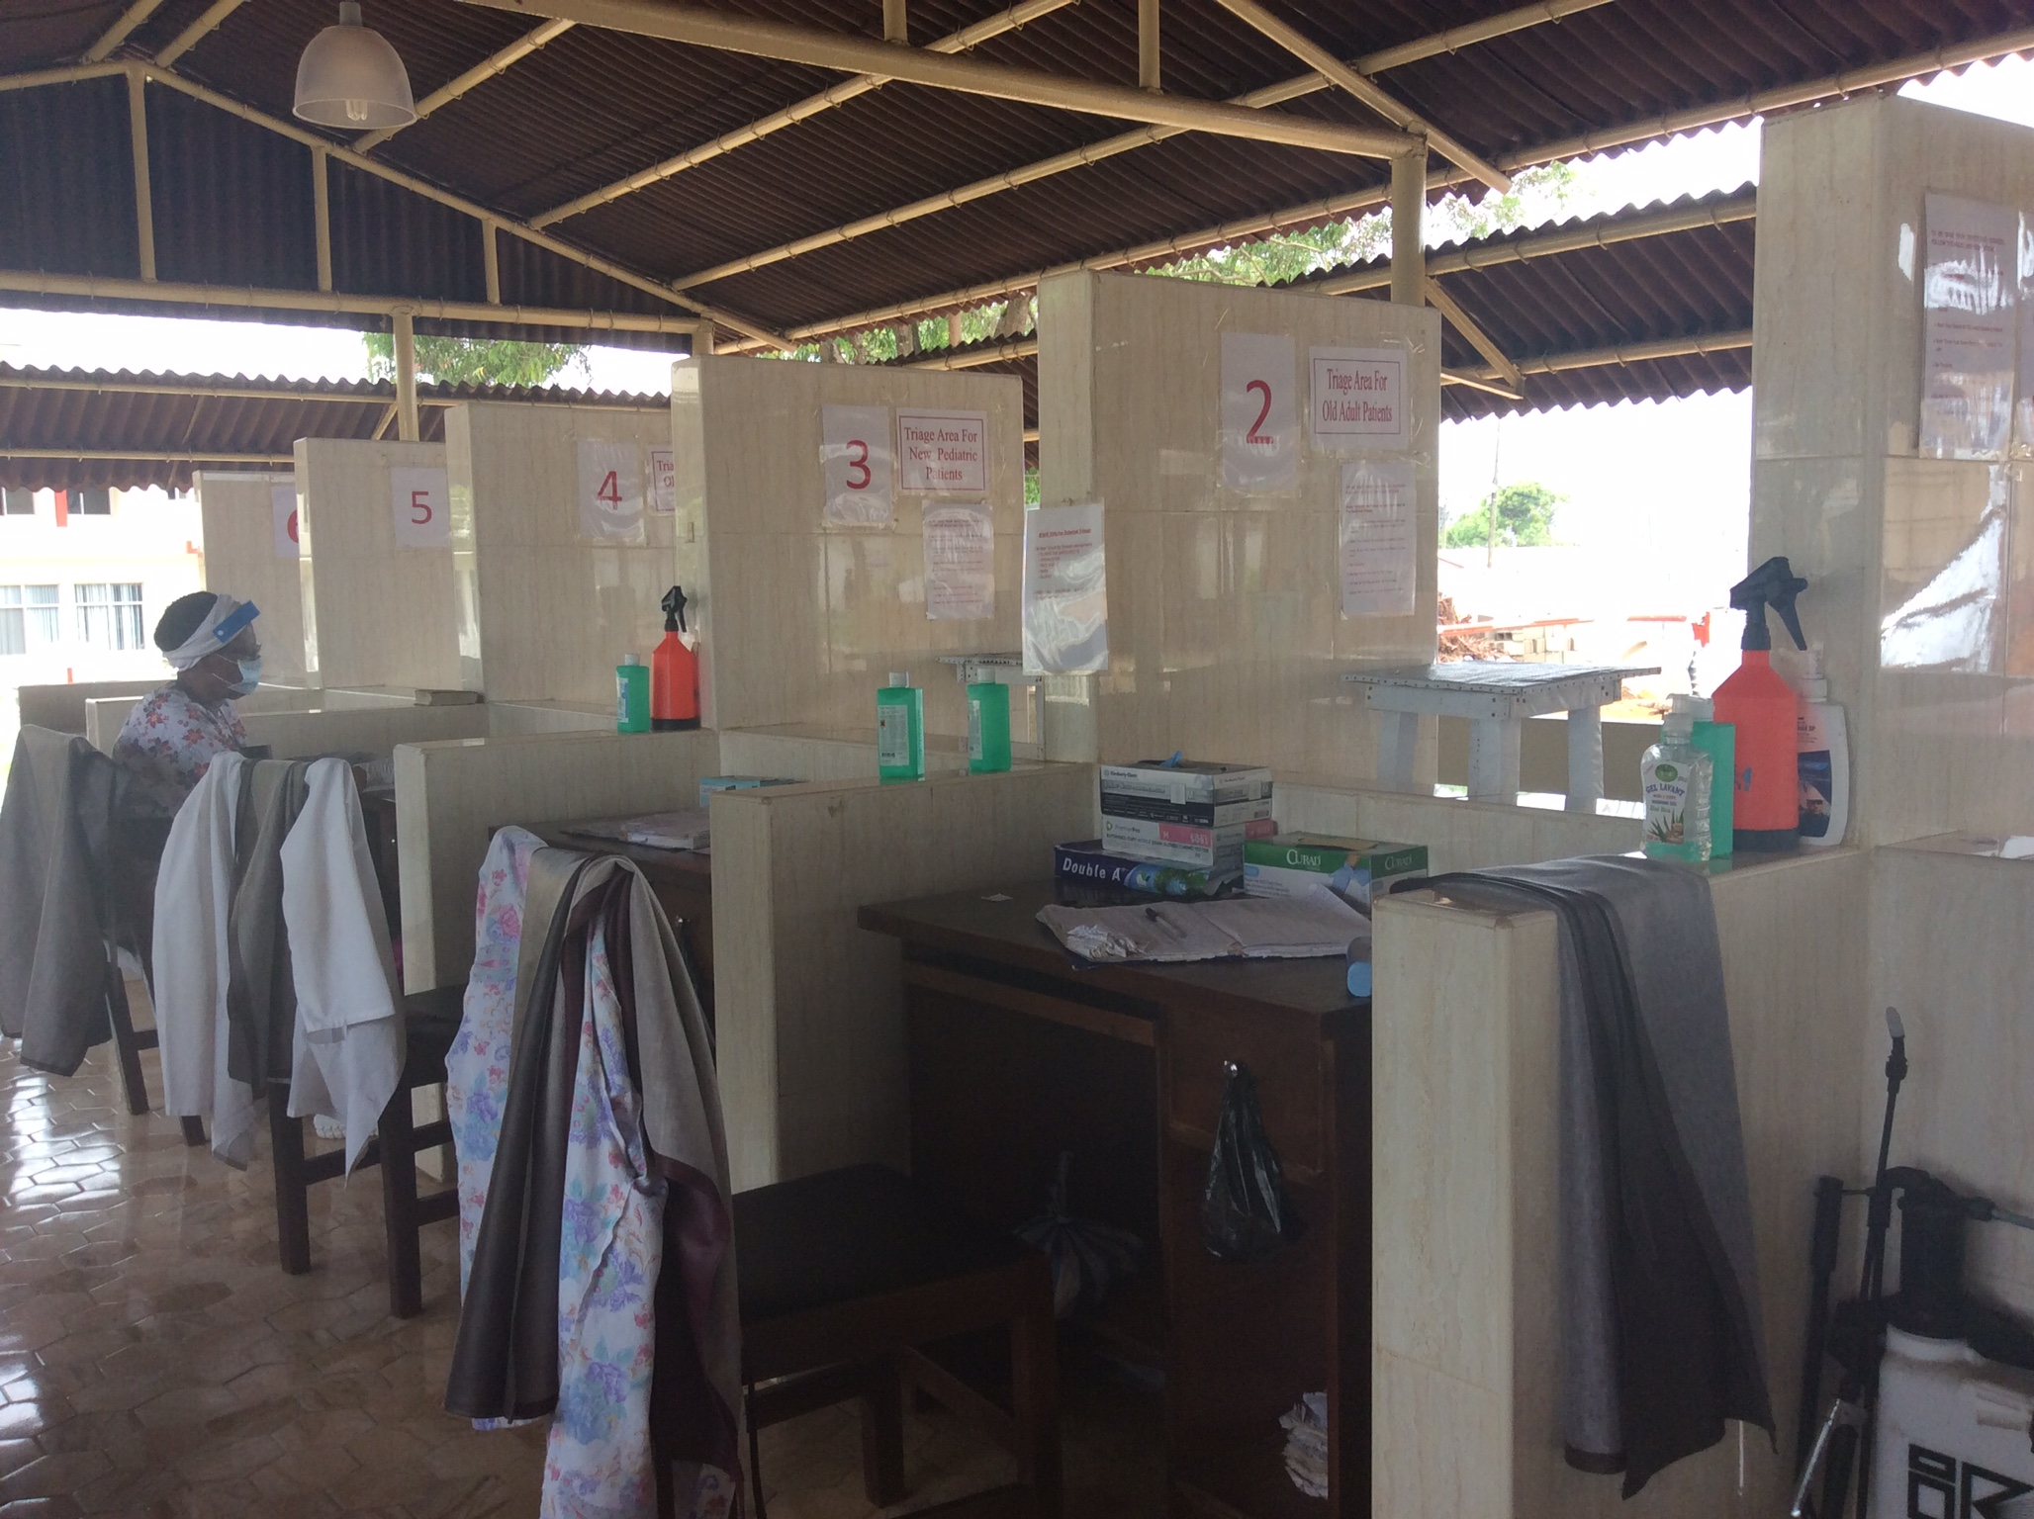
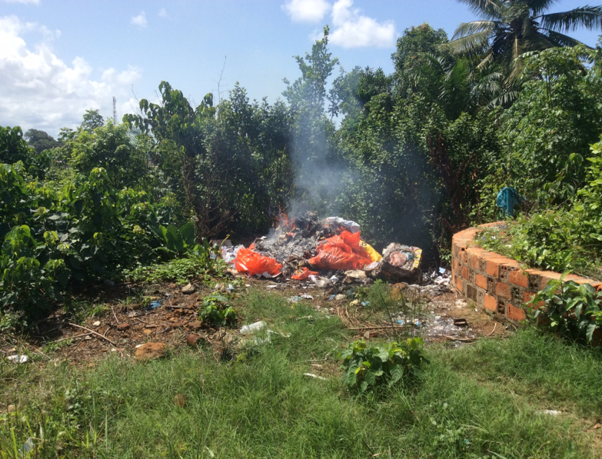
Completing assessments

Slide 3
Controls what we can what we cant
Impact
Sharing knowledge and listening
Providing resources
History of meaningful change with established connections
Good National coordinated response
What we want to provide
Short visits - 1 coordinator
Lots of other partners with defined timeframe
Small budget, 4 sites
Can what we implement be sustained
Slow response time
What they want us to provide

