Slide 1


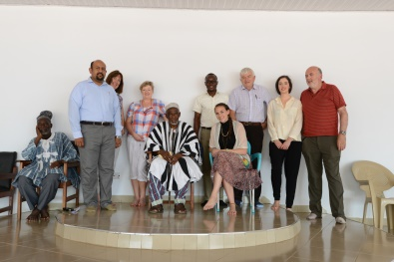
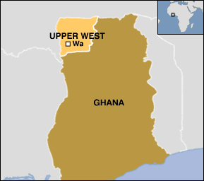
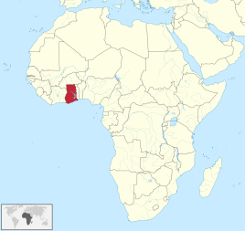
Establishing a Partnership between ULHG, UL and Upper West Region, Ghana Health Service

Slide 2
Outcome of visit
Aspects of health services in Ghana very impressive:
  Well-structured; Accessible; Community-based
  Ability to maximize health service delivery with very limited resources
Major problems identified:
  Infrastructure deficits (e.g. clinical sites, equipment, roads, transport)
  Rudimentary education & training of staff at all levels
  Shortages of personnel, and equipment
Engagement with senior health service personnel excellent:
  Warm +++; Welcoming +++; Hospitable +++
  Clear views on what they want (and don’t want) from a partnership arrangement.
  Priority: Education & training of health care staff.
  Education & training on neonatal and other resuscitation also needed at District and General Hospital levels.

Slide 3
Next steps
Partnership championed by ULHG and UL at highest levels
Partnership lead identified in Ghana
Working Group – ‘Friends of Ghana’-NGO status
Needs assessment completed
Areas of need identified-training pre-hospital and hospital provision.
In-country training symposium June 2017
  Multi-disciplinary
  Neonatal and other resuscitation
  ‘Train the trainers’

