Slide 1
An Evaluation Framework for Institutional Health Partnerships:
The ESTHER EFFECt Tool
November 2017
Dr Vicki Doyle
Ema Kelly
www.capacity-development.com

Slide 2
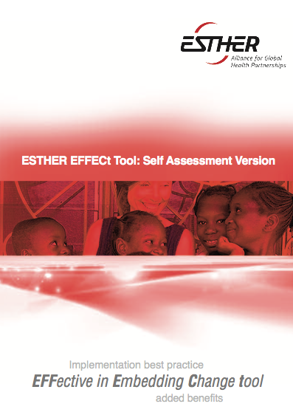
Why develop the tool?
How was it developed?
What does it look like
What does it do?

Slide 3
Do partnerships work?
Do they add value to other forms of TA?
Do benefits last?
Funding?
Funding?
Funding?

Slide 4
Project vs partnership
Short term nature of projects
Long term commitments of partnerships
Need more than ‘quick win’ or ‘short term’ evidence
How do we distinguish those partnerships which bring about lasting change?
Notes:
It is not good enough to demonstrate quick wins only!!
How can we distinguish which partnerships are effective and bring about lasting change?
Relatively easy to demonstrate short-term success of specific interventions. ‘lasting benefits’

Slide 5
Why introduce yet another measurement tool?
Assessment: help partnerships assess
  current practice
  how they embed change
Evidence: capture whether the partnership approach has lasting benefit
Learning: Build individual and institutional capacity to work towards best practice
Notes:
Improvements resultant from particular interventions that sustain over time – both intended and unintended
Only demonstrated after the passage of time:
Strengthened health workforce engaged in promoting, protecting or improving health
Sustained improvement in quality of service delivery/education
Sustained improvement in quality of care/capacity
Sustained improvements in health

Slide 6
Three tiers of evaluation
Evaluation Domain | Approach
Effectiveness of partnership intervention | Use project M&E tools (intervention specific indicators)
Quality of partnership | ESTHER quality of partnership charter
Lasting benefits of partnership approach | Developed ESTHER EFFECt Tool (uses content neutral indicators)
Notes:
Our concpetual

Slide 7
Relationship with M&E
Complementary to routine project M&E
Content neutral in terms of the specific technical intervention
Aims to measure best practice in:
  Implementation
  Capacity Building
  Sustaining & embedding change
It is generic

Slide 8
Pragmatism vs Scientific Rigour
Comprehensive literature review
Analysis of frameworks and indicators from published and grey literature (INGOs/donors):
  Capacity development
  Workforce development
  Institutional strengthening
  health systems strengthening
Analysis of frameworks: applicability, feasibility, ease of use

Slide 9
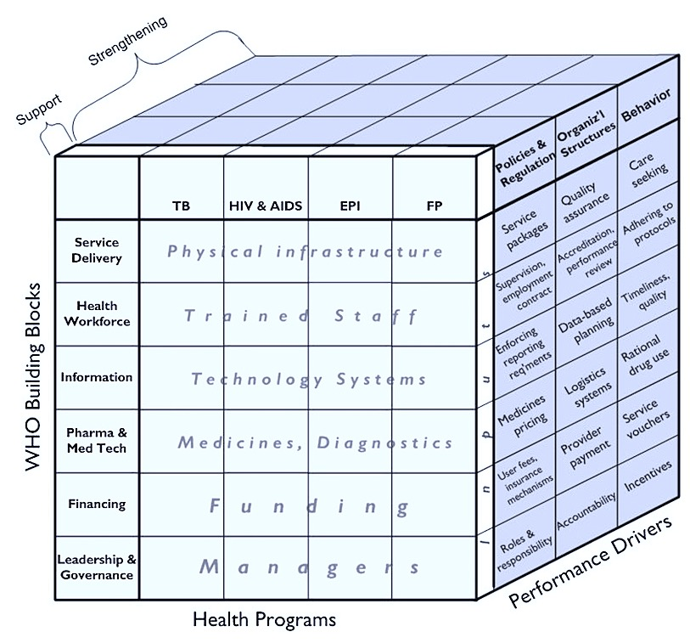
Using the thinking from the HSS cube
Notes:
Moving from support to strengthening
When we think about sustainability
Embeddedness
Institutionalisation
When we think about capacity development
Moving from being able to do x to being able to adapt to new circumstances

Slide 10
What does the tool look like?
Modular
  Implementation best practice
  Embedding change
    Curriculum development and use
    Reach of capacity building
    Capacity building best practice
    Whole institution strengthening
  Added benefits
    Institutional and individual level

Slide 11
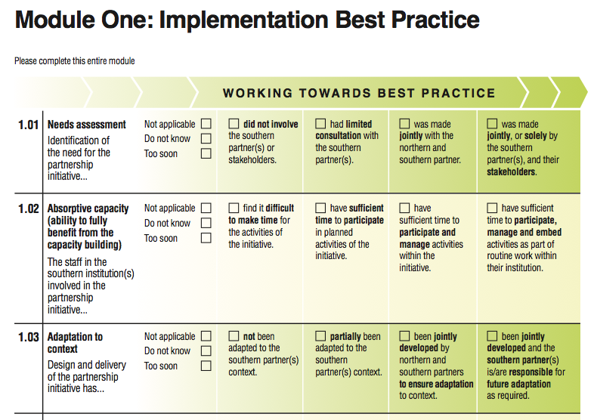
Notes:
Modular
Indicators that have various statements associated with them associated with different stages of development
Ability to benchmark against each other
Ability to see change over time
Ability to quantify these changes

Slide 12
Themes
Embedding Change
Needs assessment
Added Value
Networking and partnership
Staff motivation
Absorptive capacity
Adaptation to context
Southern partner ownership
Team implementation
Activity planning
Evaluation, learning
Harmonisation
Alignment
Dissemination
Empowerment
Staff retention
Staff recruitment
Peer support
Spread/scale up
Reverse innovation
Personal professional skills
Personal management and communication skills
Curriculum reach
Curriculum update
Curriculum delivery
Learning & teaching methods
Critical mass
Capacity to deliver
Range of capacity development
Evidence-base
Teams
Application of learning
Changes in practice
Feedback
Access to equipment/materials
Advocacy
Motivation
Systems thinking
Resilience
Implementation

Slide 13
Piloting
Tool administered as online survey: 20-40 mins
Seven partnerships
  France
  Norway
  Ireland
  UK
Equal representation North and South
Non-English first language speakers
Diverse types of partnership
Notes:
Northern and Southern coordinators complete the online tool (20 - 40 mins)
Sixteen survey respondents
Ten follow-up interviews

Slide 14
“I was really motivated to complete the tool as I was learning from it… I am not a global health expert but a clinician who works in global health … I really began to start understanding how I might measure things … the rubrics were really education when completing it.” (Northern Partner)

Slide 15
“This will help us focus on sustainability – to really look at how much is being taken up by the local team and to really look at whether we are impacting on one area or the whole facility. We need to ensure that what we do is escalated. Using this as a self-assessment …........ it will help us focus on what we want to achieve.” (Southern Partner)

Slide 16
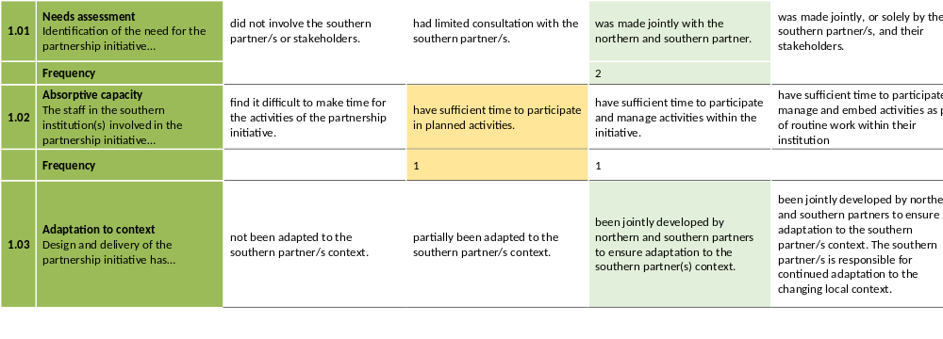
Report Output: One partnership

Slide 17
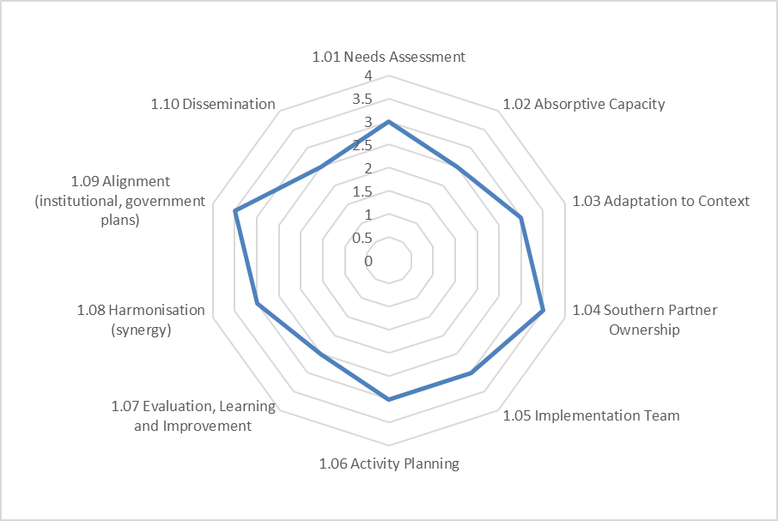
Report Output: One Partnership

Slide 18
Usefulness & Relevance
Questions were seen as relevant, irrespective of technical project intervention
Opportunity to discuss differences in perspective
  Independently assessed by both North & South
Opportunity for shared learning
Gave insights for working at advanced level
Complementary to routine M&E
Appreciated focus on sustainability

Slide 19
Conclusion
Self Assessment Tool is acceptable, relevant and useful
Available as a paper-based tool now
Online self assessment tool early 2018 (www.esther.eu)
Further research required for its use in evaluating a portfolio of partnerships
Notes:
Factor analysis

Slide 20
Thank you
Vicki Doyle vdoyle@capacity-development.com
Ema Kelly ekelly@capacity-development.com
www.capacity-development.com

