Slide 1



‘Constructing a Global Learning Partnership in Physiotherapy:
An Ireland-Uganda Initiative’
Dr Cliona O’Sullivan,
University College Dublin, Ireland
Mr Herman Kazibwe,
Mbarara University of Science and Technology, Uganda

Slide 2
Rehabilitation 2030
80%
20%
‘Global trends in health and aging require a major scaling up of rehabilitation services in countries around the world and in low- and middle-income countries in particular’,
WHO 2017

Slide 3
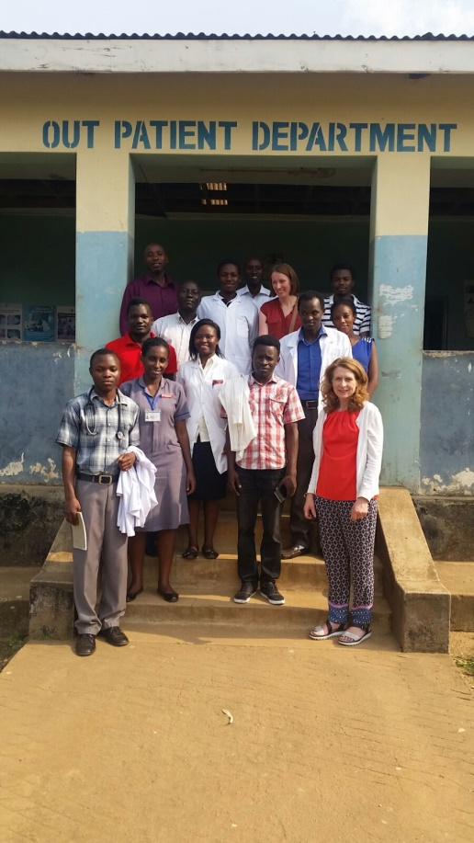
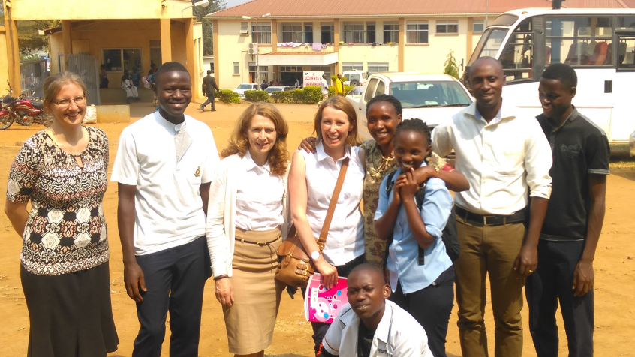
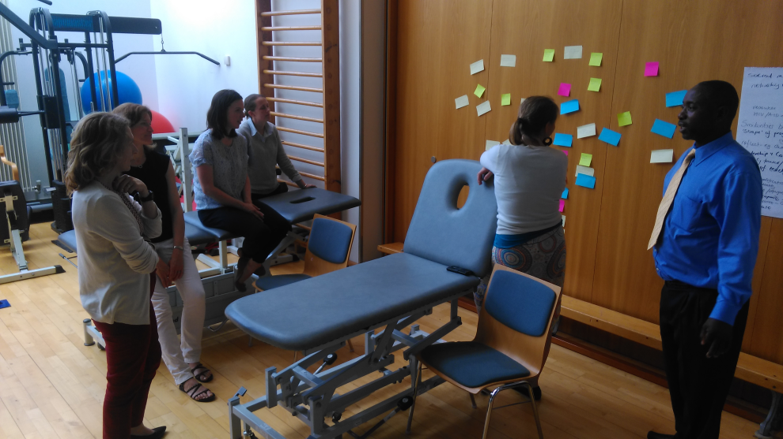
Aim: To build education and research capacity in physiotherapy
Reciprocal visit
Met with different university colleagues
Visited local hospitals,
rehabilitation providers
Workshops to determine priorities
‘Appreciative inquiry’ methodology,
(Sandars and Murdoch Eaton, 2016)

Slide 4
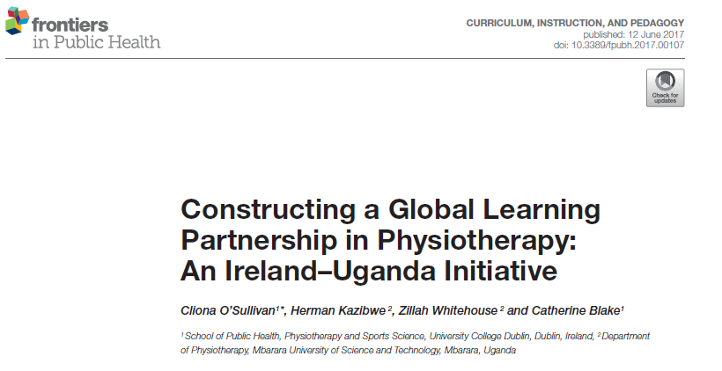
3 priorities
Develop joint e-learning opportunities
Explore post-graduate study opportunities
Develop joint clinical placements

Slide 5

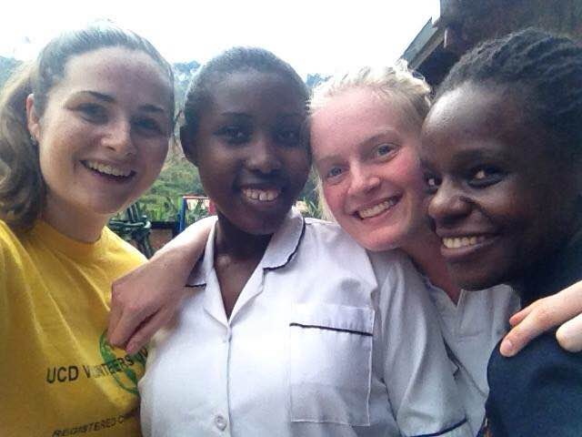
Joint clinical placement

Slide 6
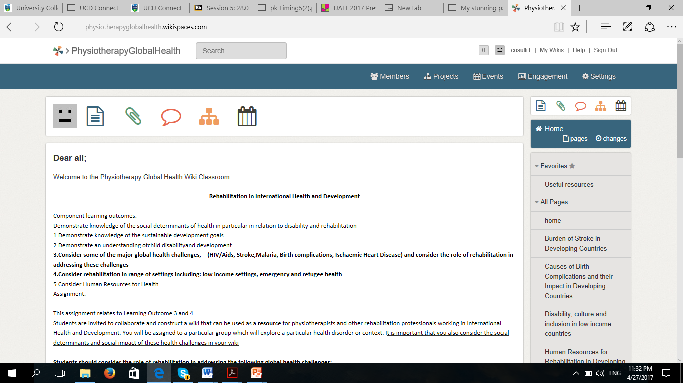
Joint e-learning initiative:
UCD Pilot using Wiki Spaces Classroom
Notes:
Instructions
6

Slide 7
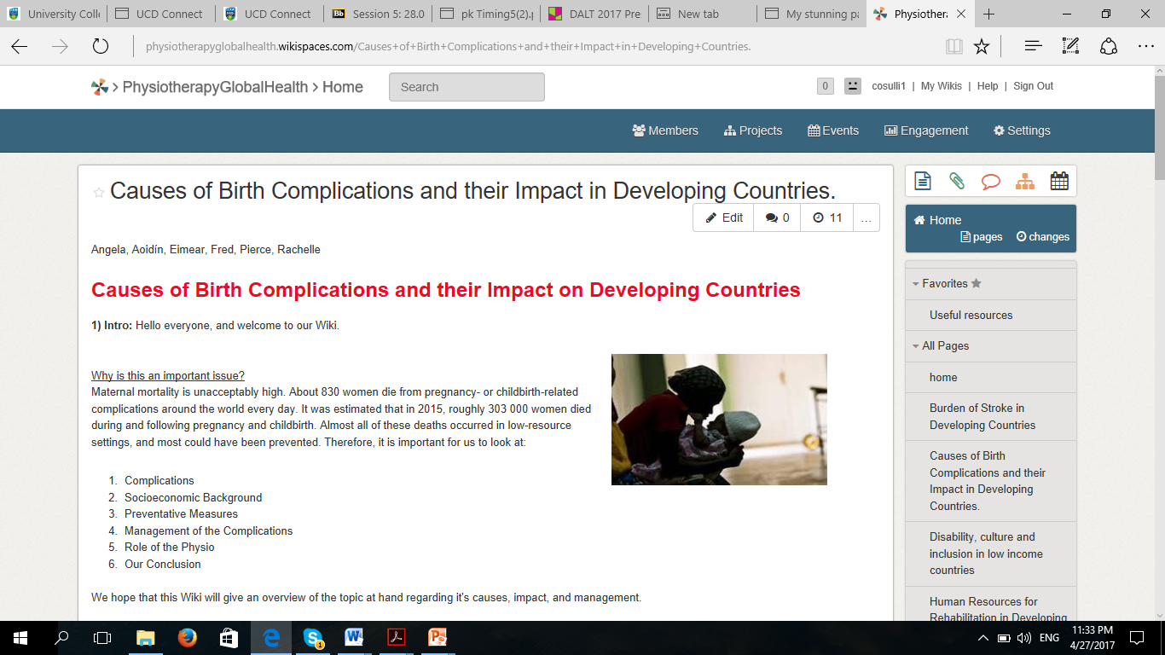
Notes:
Sample of student work
7

Slide 8
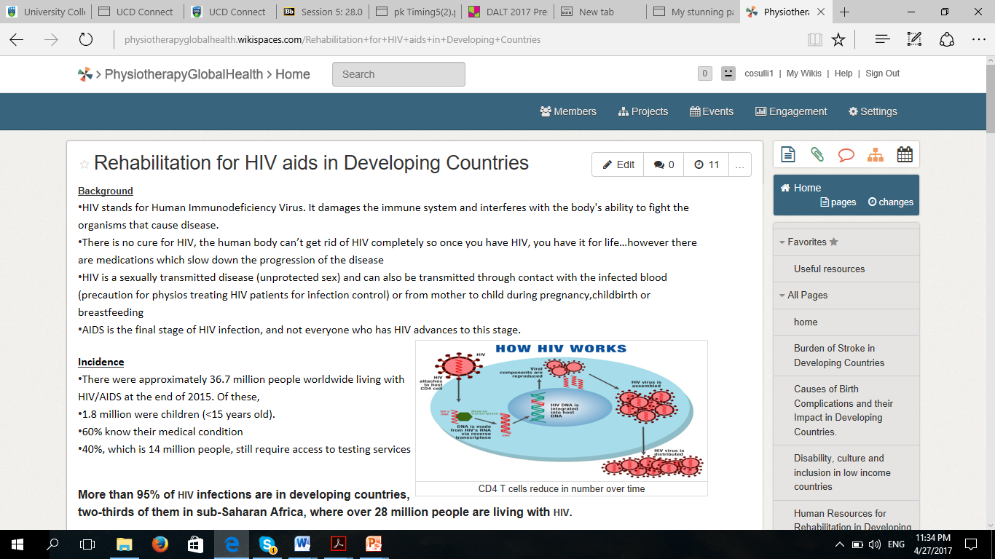
Notes:
Sample of student work
8

Slide 9
Positives
Challenges
Strong partnership based on mutual understanding and respect
Regular communication
Enhances student experience
Opportunities for collaborative learning
Shared information between faculty members
Informal institutional commitment
Funding opportunities for post graduate scholarship
Connectivity
Time!

Slide 10
THANK YOU
QUESTIONS?

