Slide 1
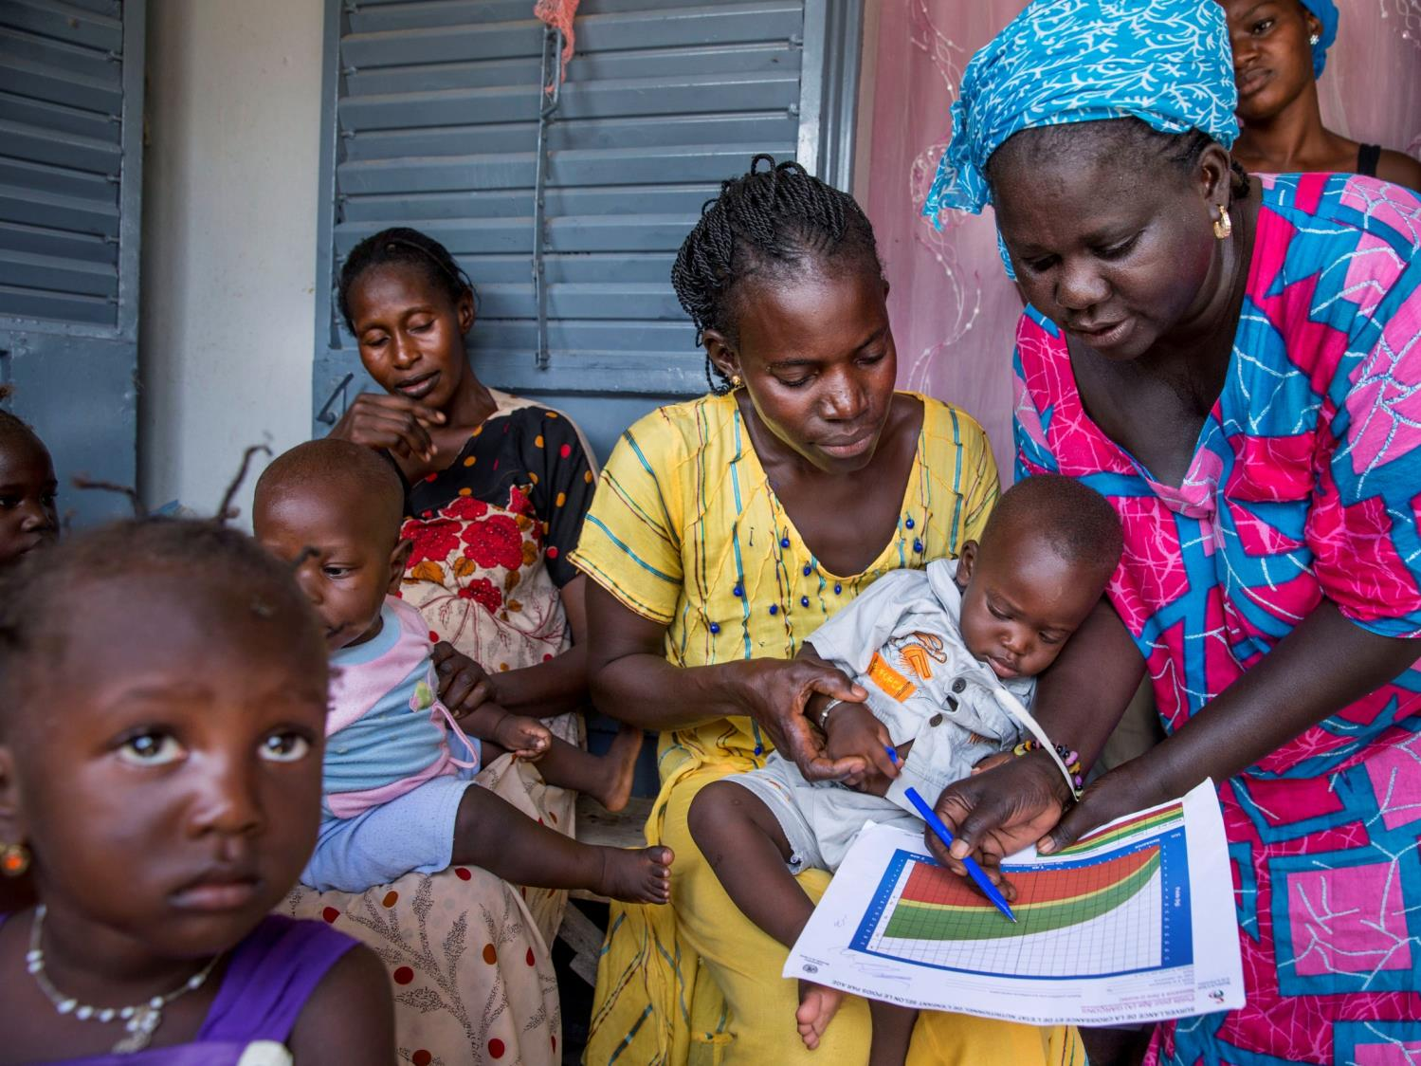

Institutional Health Partnerships to Achieve Universal Health Coverage
Pape Gaye
President & CEO
IntraHealth International
Notes:
Today I want to talk about how we can reach the last mile in our quest to achieve UHC.
Since the release of the World Health Report in 2006 that focused on the health workforce, the focus on IHPs has mostly catered to secondary and tertiary levels.
To achieve UHC by 2030, we need to design IHPs to also focus on PHC so this whole layer of the system is not left behind.

Slide 2
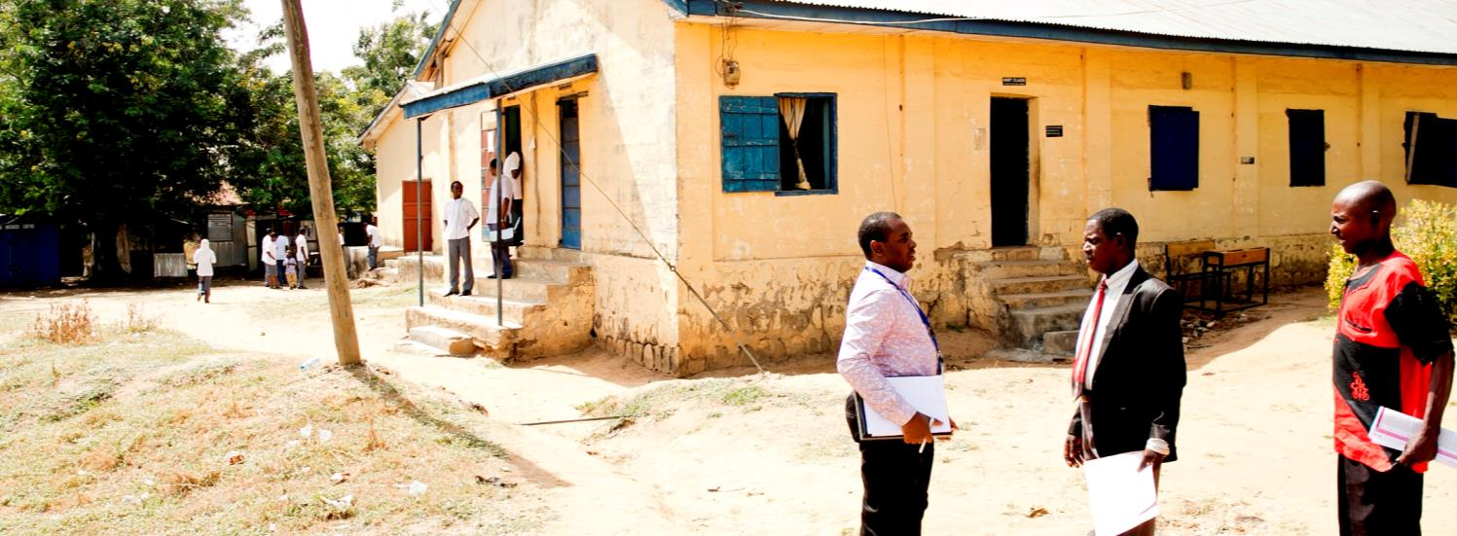
Challenges
Linkages with small, rural partners
Failure to focus on primary health care
Rural connectivity and communication
Notes:
What are some of the challenges to focusing IHPs on PHC?
There are logistical challenges.
It is much easier for a faraway partner to fly into a capital city and arrive at a large urban university rather than find and connect to a small, rural college.
There is often a lack of connectivity of rural health institutions. Reliable fast-paced internet is needed to communicate remotely.

Slide 3
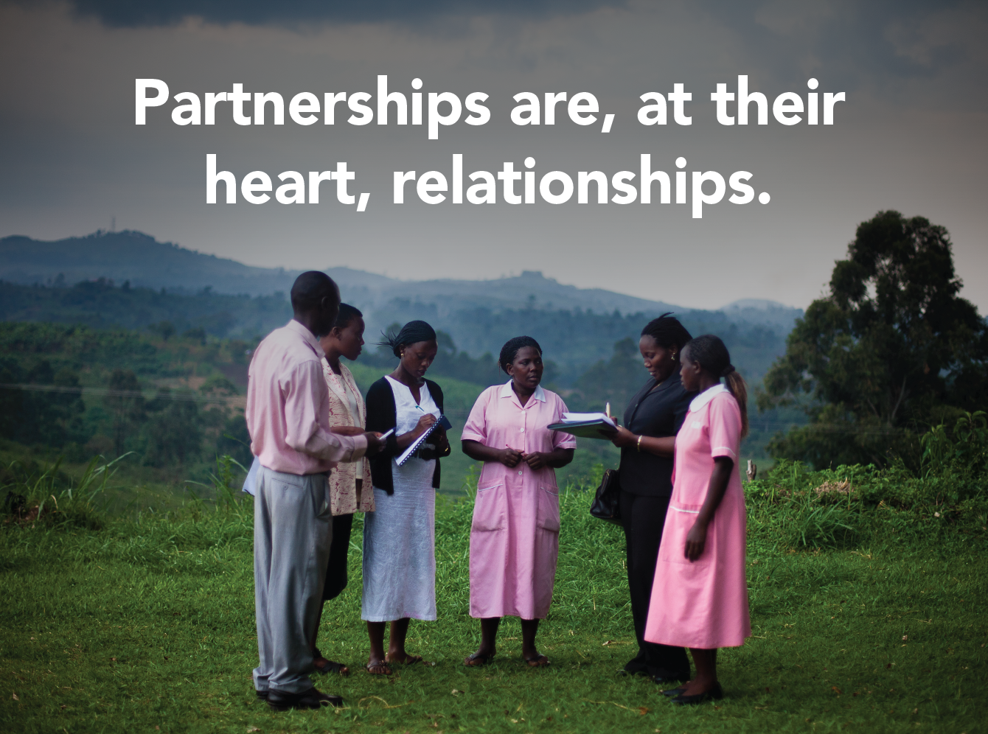
VISUAL SLIDE
Notes:
Cultural compatibility and trust can sometimes be more difficult to come by.
Partnerships at their heart are relationships.
We have been good about forming relationships at the tertiary level, but we are just starting to facilitate these relationships at the primary level.
Northern institutions have the opportunity to meet Southern institutions at at large global conferences much like this one, which affords an opportunity to strike up conversations and build trust with each other. Doctors and other specialized professionals are often in attendance instead of more basic community-health centered cadres or rural institutions that focus on PHC.

Slide 4
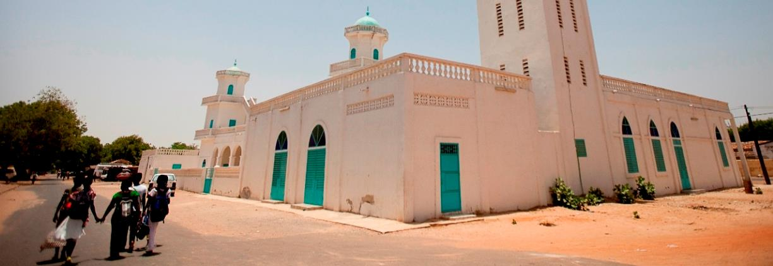
Recommendations & Solutions
Local-local partnerships
Don’t forget faith-based partners
More centers of excellence
Notes:
We cannot forget about forming relationships with the faith-based sector who have quietly been doing the work of providing training and health care at the primary level in more rural places. Let’s include the African Christian Health Associations Platform and the other religious leaders (from the Muslim and Jewish faiths) at the table and leverage their contributions, which already account for a large percentage of health services in many countries.

Slide 5

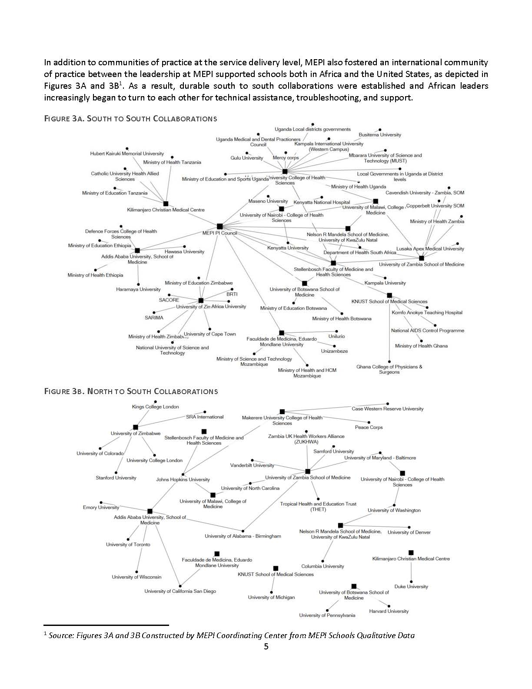
Notes:
Let me provide an example from the Medical Education Partnership Initiative (MEPI) that ended a few years ago as a backdrop to some of my recommendations. MEPI was a five-year, $130 million initiative designed to develop, expand, and/or enhance models of medical education in sub-Saharan Africa. While MEPI enjoyed some great successes, perhaps the most enduring legacy is the unexpected South-South community of practice between the leadership at MEPI-supported schools and other academic institutions in sub-Saharan Africa that was not part of the original program design.
We have for decades had well-established partnerships between North-South and West-East. However, it is long due to facilitate more robust partnerships between South-South and East-East. I am talking both monetary support and relationship-building. In other words, we need more IHPs that are local-local in low-resource settings.

Slide 6


Slide 7
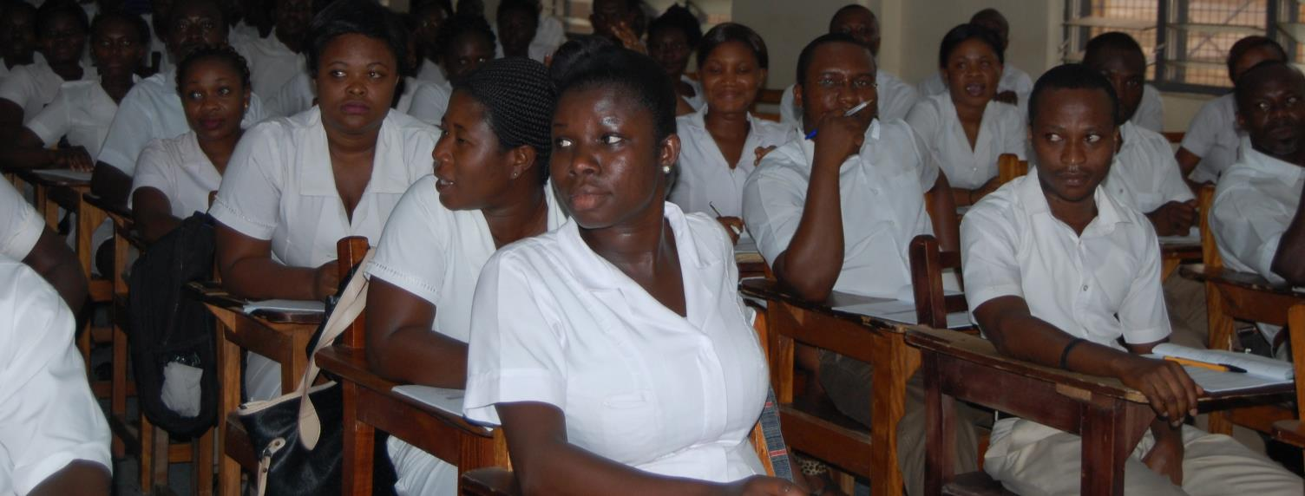
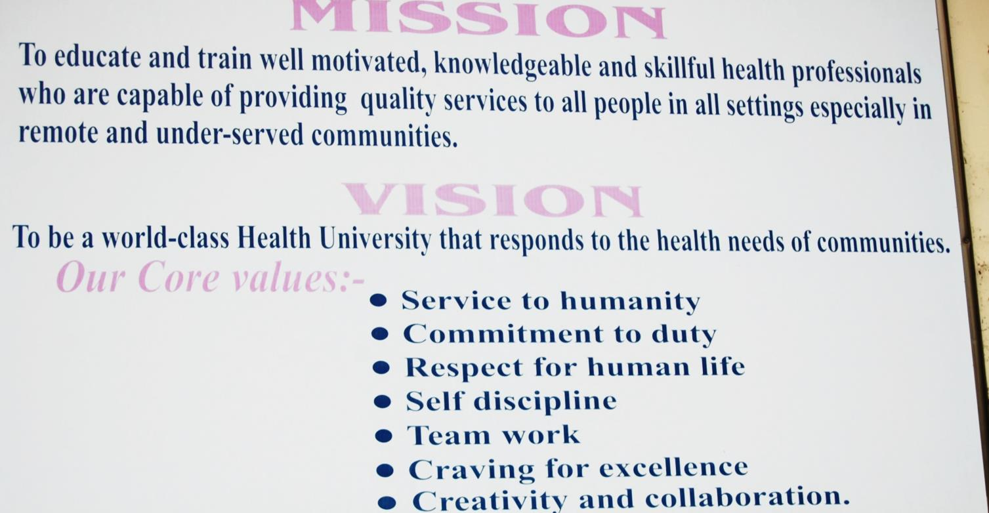
Kintampo Rural Training Health Institute
Belize
Center of excellence
Notes:
We need to form more centers of excellence as local example of innovative ways to operate. Kintampo Rural Training Health Institute comes to mind as a school in Ghana that has formed a strong reputation locally and been able to form IHPs internationally. Its strong leader, Emmanuel Adjase, has been part of global groups that helped kickstart those relationships with the likes of University of Utah, University of Winchester, and the University of South Hampton.

Slide 8



Discussion
Contact:
Pape Gaye
pgaye@intrahealth.org
Follow us:
facebook.com/intrahealth
twitter.com/intrahealth
www.intrahealth.org

