Slide 1
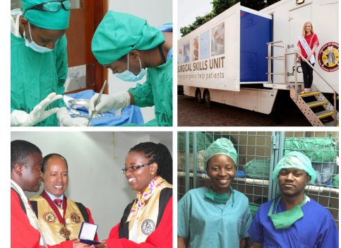


The RCSI / COSECSA Collaboration Programme
Miliard Derbew COSECSA President

Slide 2

College of Surgeons of East Central and Sothern Africa (COSECSA) Mission
  To promote access to and excellence in Surgical Care, Training and Research.

Slide 3
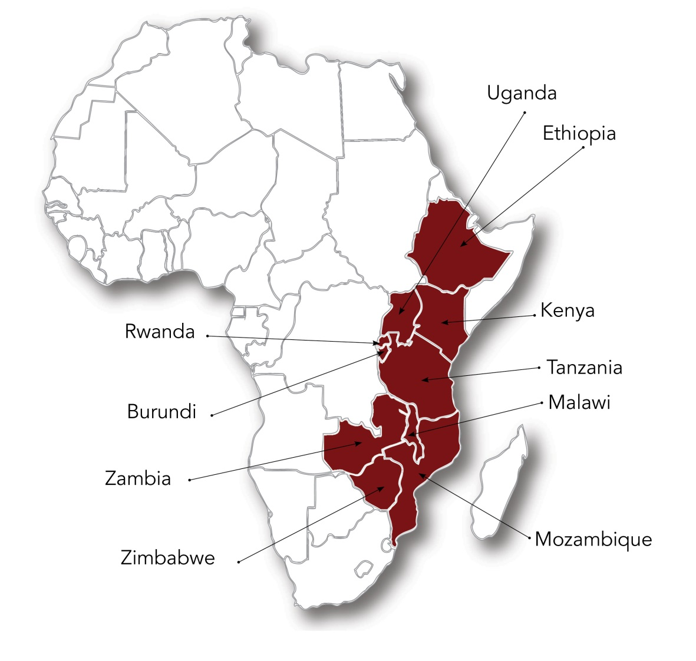
College of Surgeons of East, Central and Southern Africa (COSECSA)
  Surgcial training - seven specialities and sub-specialties
  Over 400 surgical trainees in 62 training locations.
  Since 2004, almost 300 specialist surgeons have graduated.

Slide 4

General Concept: Partnership
To enhance vision and mission’s of the institutions
Increase surgical workforce capacity
Improve quality of surgical service
Exchange programs/Educational materials for fellows and faculty
Distance and innovative learning programs
Joint research

Slide 5
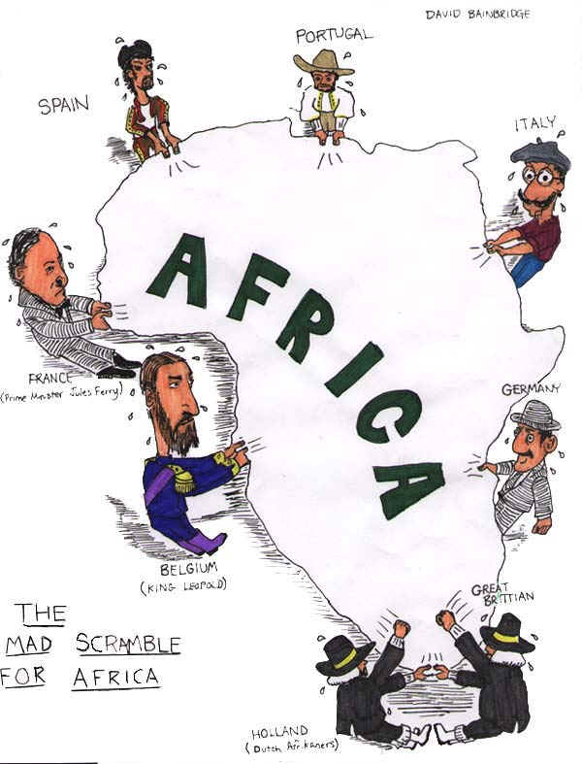
Academic Partnerships for Medical and Surgical Education

Slide 6
Advantages and Disadvantages of Partnership
Potential benefits for hosts
  Increase workforce/institutional capacity
  Access to resources - electronic libraries, (Ptolemy)
Potential benefits for visitors
  Career advancement, publications
  Professional intrigue
Mutual potential benefits
  Reciprocal learning - social constructivism

Slide 7
Challenges of Partnerships
Driven by the northern partners agenda
    Donor Driven Concept
Inadvertently contributing to brain drain
Based on short-term goals rather than long-term capacity-building interventions

Slide 8
Focus areas in Partnerships
Is it Problem oriented?
Is it policy Oriented?
Does it need modification?
  Training: University based/ Hospital based
  Inter disciplinary or more of confined?
  Does it address the SDG?

Slide 9
The Problem
5 billion people worldwide (including 93% of people in Sub-Saharan Africa) lack access to safe, affordable, timely surgical care.

Slide 10


















17 Goals
169 Targets
Global Surgery Symposium, Toronto
February 17, 2017

Slide 12
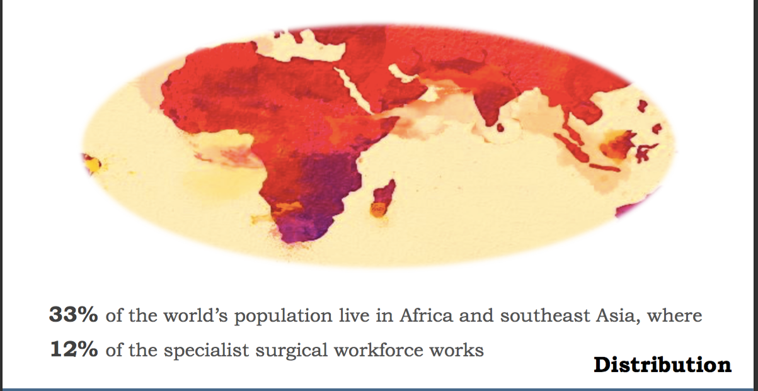
In addition, ………..
Commission on Global Surgery, Lars Hagander, Commission Launch, May 6, 2015 Boston, USA

Slide 13
The Lancet commission report
“Reported specialist surgical (SAO) workforce density varied widely between countries, from 0.15 (Sierra Leone) to 278.38 (Monaco). Many countries, particularly low- or lower-middle income countries, will need to train additional providers to reach the Commission’s threshold of 20 (SAO) specialist surgical providers per 100,000 population. Combining data from this effort with previous data, specialist surgical workforce density is now available for 175 countries”.

Slide 14
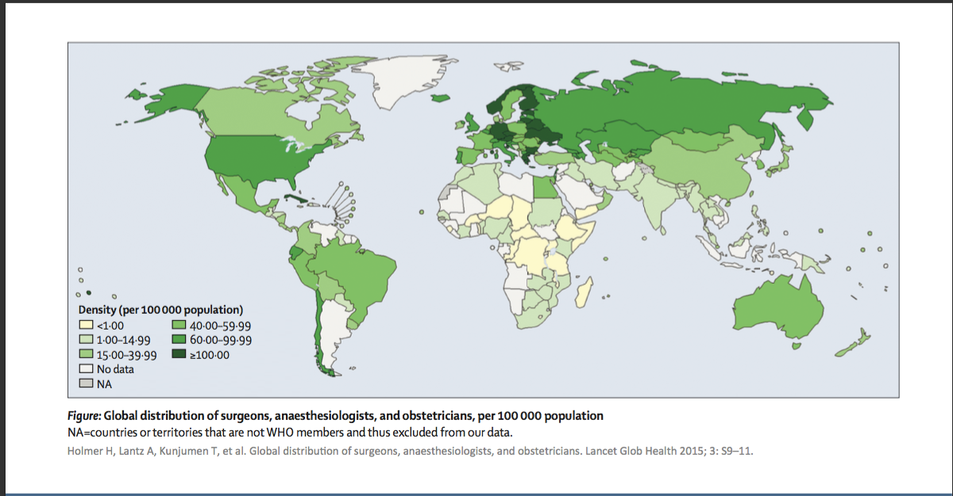
Global Distribution: Present

Slide 15
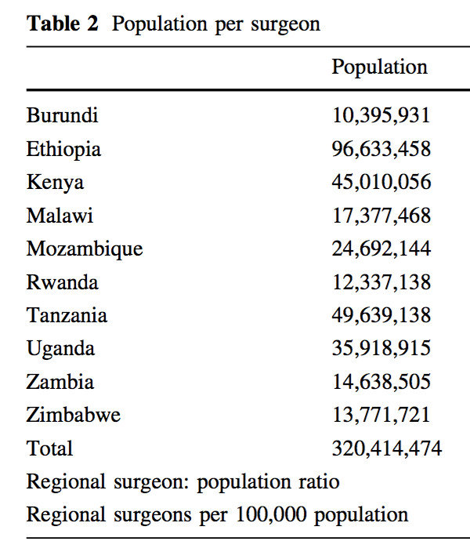
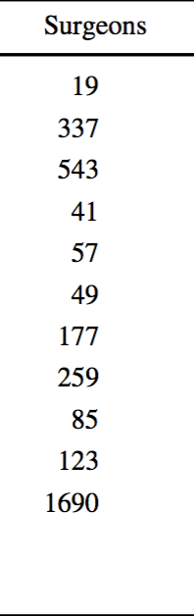
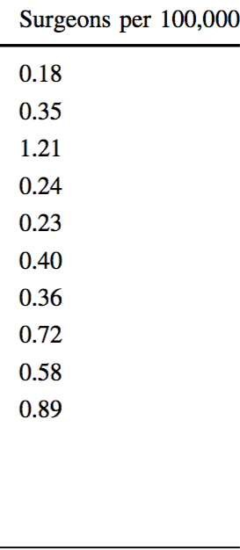
Eric O’Flynn¹ • Judith Andrew² • Avril Hutch¹ • Caitrin Kelly³ • Pankaj Jani^{2,4} • Ignatius Kakande^{2,5} • Miliard Derbew^{2,6} • Sean Tierney¹⁰ • Nyengo Mkandawire^{2,7,8} • Krikor Erzingatsian^{2,9 .}
The Specialist Surgeon Workforce in East, Central and Southern Africa: A Situation Analysis. World J Surg (2016) 40:2620–2627 DOI 10.1007/s00268-016-3601-3

Slide 16
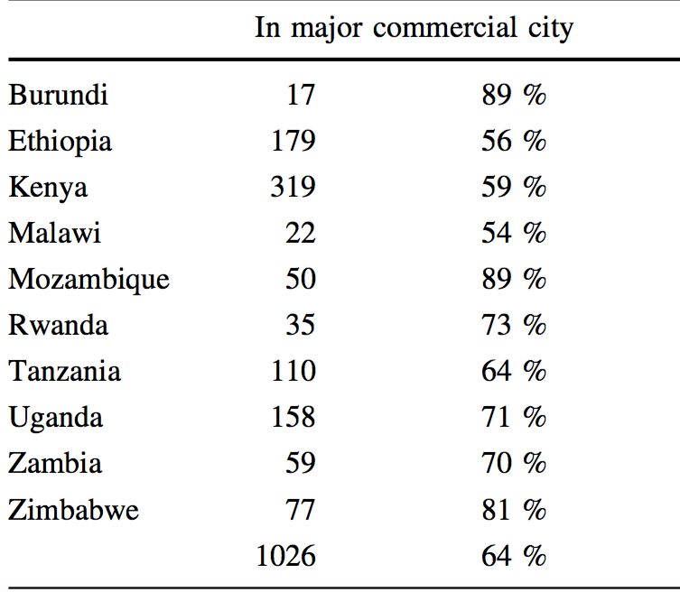

Slide 17
RCSI/COSECSA Collaboration Programme Rationale
Local organisations, local qualifications
Ability to scale up training
RCSI/COSECSA Collaboration supports all aspects of rapid scale up

Slide 18
The RCSI/COSECSA Collaboration
A cross–college collaboration since 2007 with a wide range of activities
involving a large number of RCSI staff and fellows.
Funded by Irish Aid with a significant in-kind contribution from RCSI.
Overseen by a steering committee made up of Irish-based and African-
based committee members .
Meets 3-4X in a year

Slide 19
What Does Work
Institutional, not personal
Project helps the Southern institution meet their own targets
Non-clinical cooperation
Dedicated staff
“50-50” representation in governance structures

Slide 20
What Doesn’t Work
When it becomes “someone’s project”
Creates significant new demands on existing staff on either side
Innovation or equipment without capacity building
Unclear lines of responsibility

Slide 21
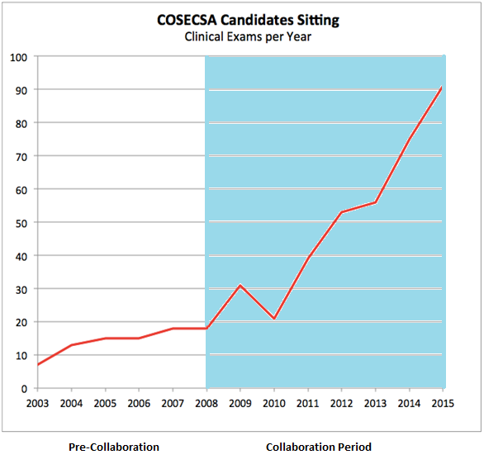
Progress
Notes:
These are the numbers sitting Clinical and Viva exams.
To sit, candidates must have already passed the written exams

Slide 22

The Key To Successful Partnership
Notes:
The “Paris Declaration on Aid Effectiveness” is a set of best practise principles in international aid. This page is a lighly

Slide 23

Thank You!

