Slide 1
Partnership-in-practice: strengthening the health workforce in Mozambique
Ministry of Health Mozambique - Health Service Executive Ireland
ESTHER Programme, Irish Aid,
International Society for Quality in Health Care
Jonas Chambule, Irish Aid, Mozambique
Dublin, 14th November 2017

Slide 2
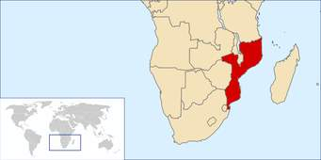
Country Context:
27 million habitants
Cost Land 3000 km
Maternal deaths 408/100.000
Infant Neonatal deaths 64/1000
HIV Prevalence 11.5%
Life expectancy 53 years
Health Services coverage 60%
Infectious diseases (Malaria, TB)
Chronic Malnutrition One in two Children Under 5

Slide 3

Where we started?
St James Hospital in Dublin, 4th June 2014
Notes:
This Partnership agreement between the Irish Health Service Executive and the Mozambican Ministry of Health marked a new and exciting phase in the relationship that exists since 1996, almost 21 years.
With this agreement marked the first time that staff from our respective health institutions work together under the common objective of improving the quality and safety of health services to the people of Mozambique.

Slide 4
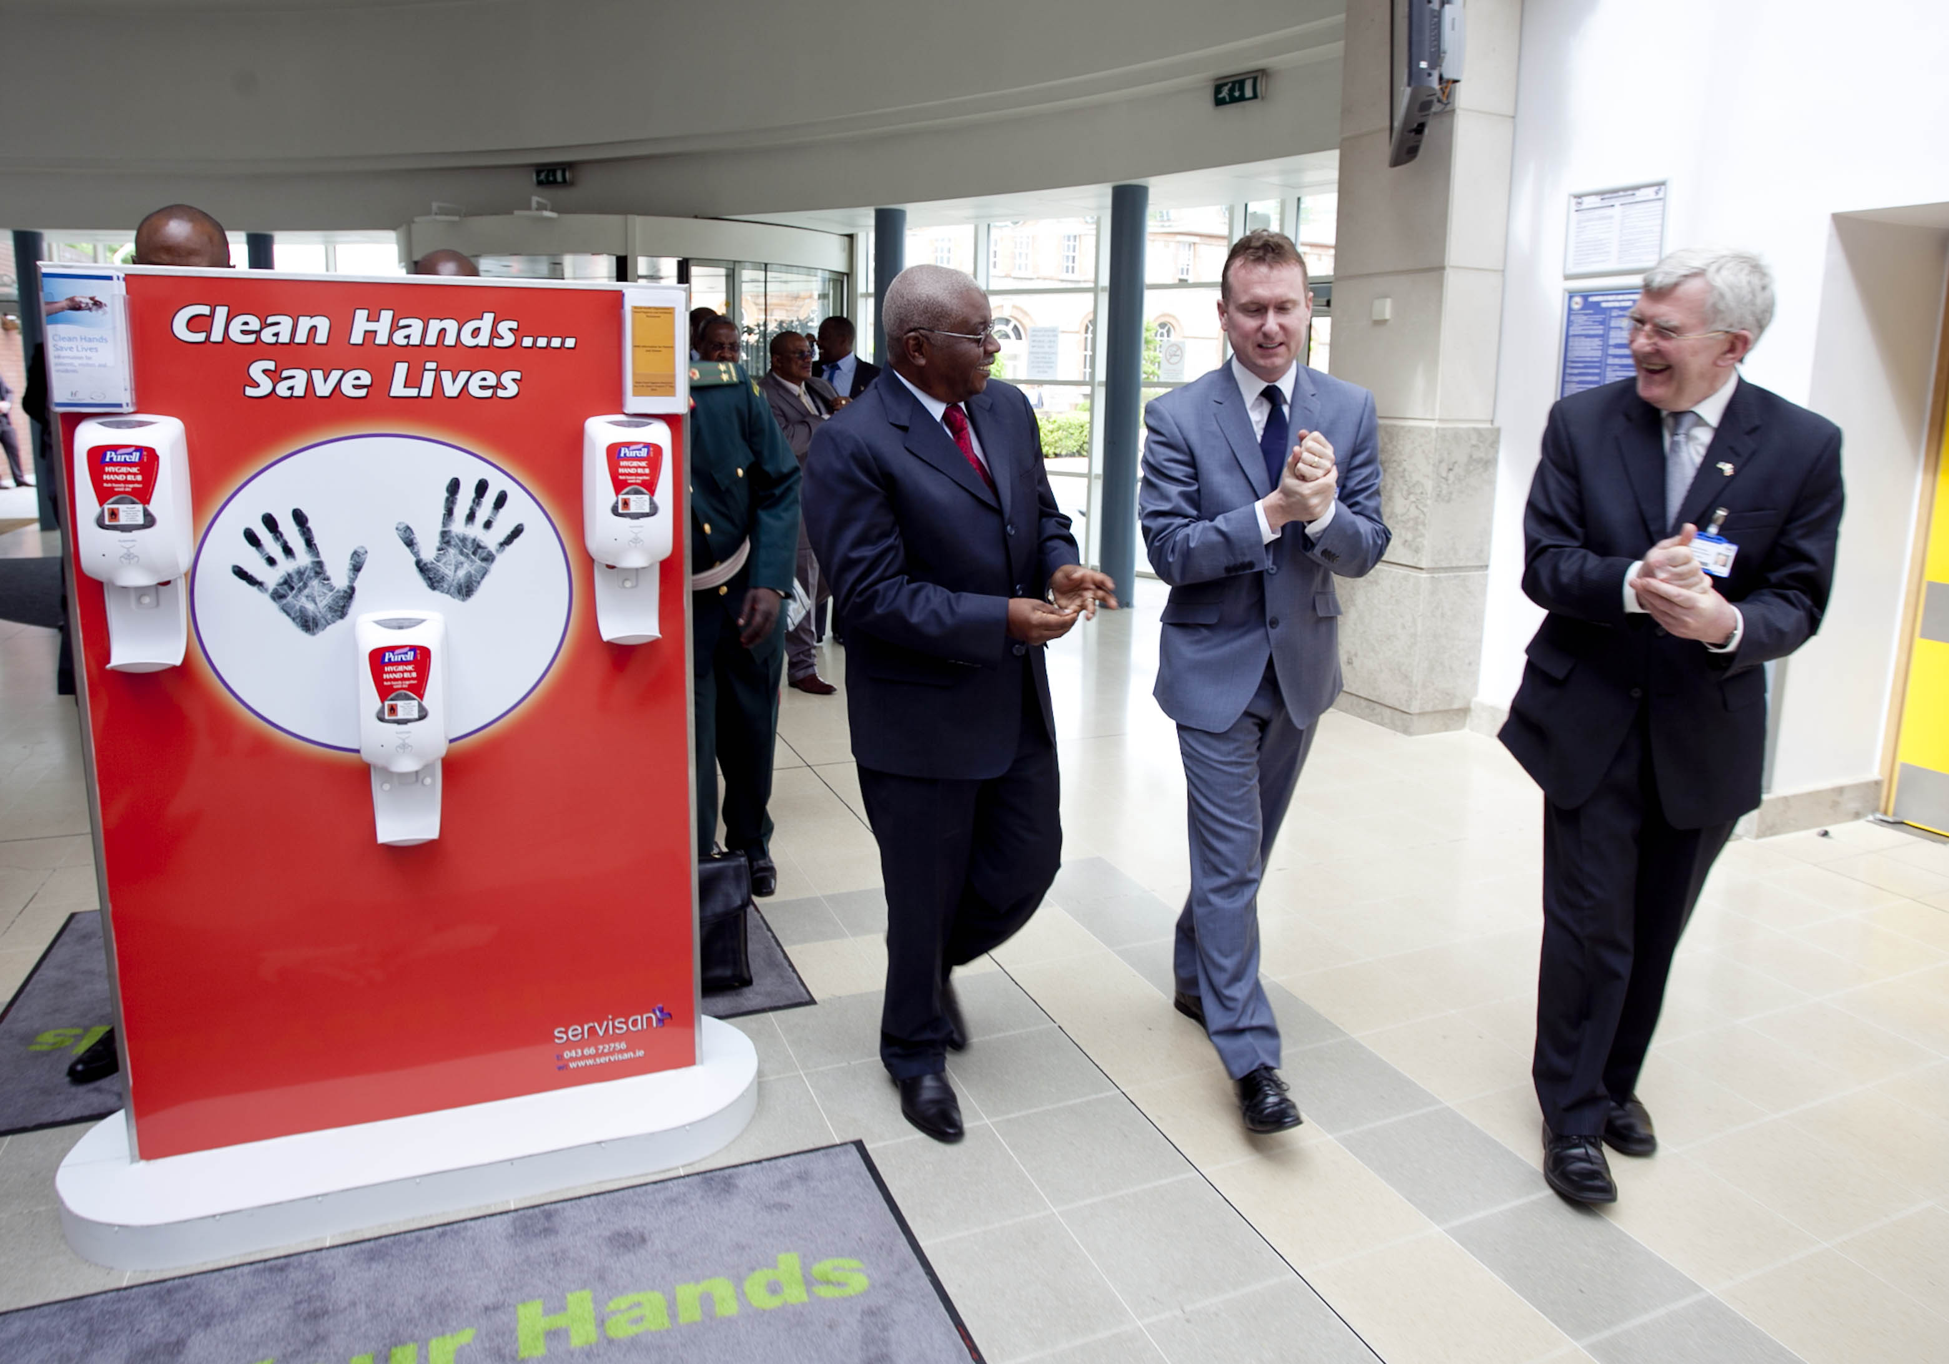
Notes:
There was a great believe that both sides are highly motivated to maximise the potential that this agreement has to offer.

Slide 5
Develop a shared partnership:
MOH Mozambique
HSE Ireland
Irish Aid

Slide 6
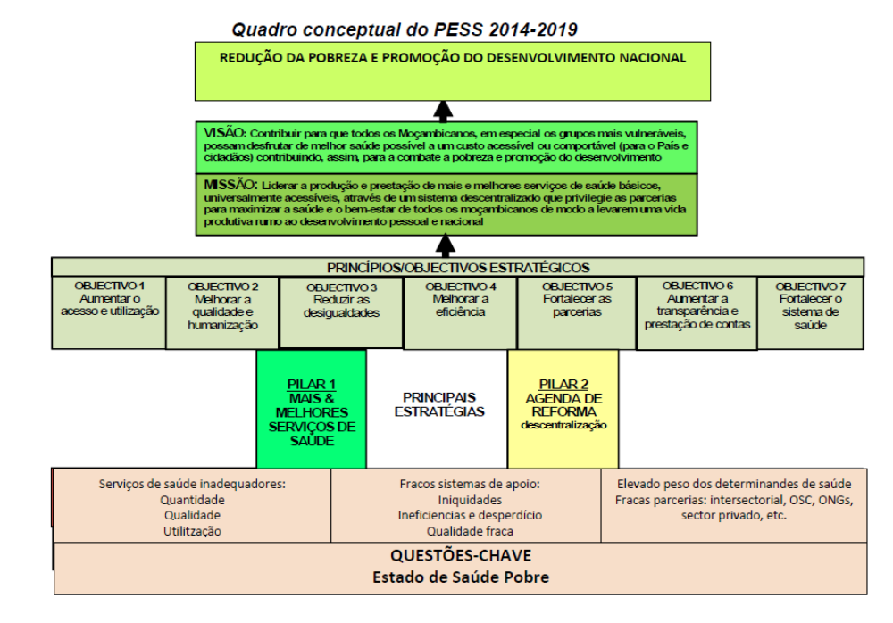
Where this Partnership fits within the Sector Strategic Plan

Slide 7
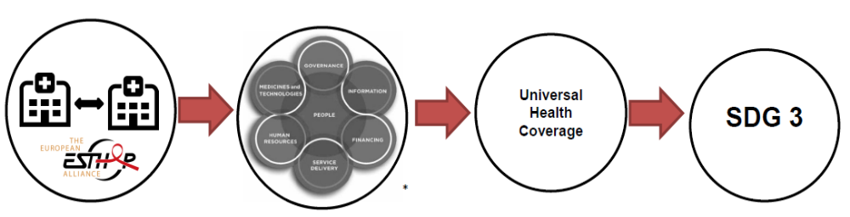
Partnerships contribute to Health Systems Strengthening
Theory of Change
Innovative and improved practices in health management and service delivery not only benefit the involved institutions but feed into local, national, technical, policy discussions and decisions and thereby contribute to address systemic challenges and consequently contribute to universal health coverage and achieving healthy lives and wellbeing for all at all ages (SDG 3).

Slide 8
PRACTICAL Model adopted:
“Together we go further” - (Dr Elenia Amado, MoH Mozambique)
Capacity building in Quality Improvement
  Sharing resources and experience
  Collaboration with ISQua
  Training teams from MoH and 15 hospitals

Slide 9
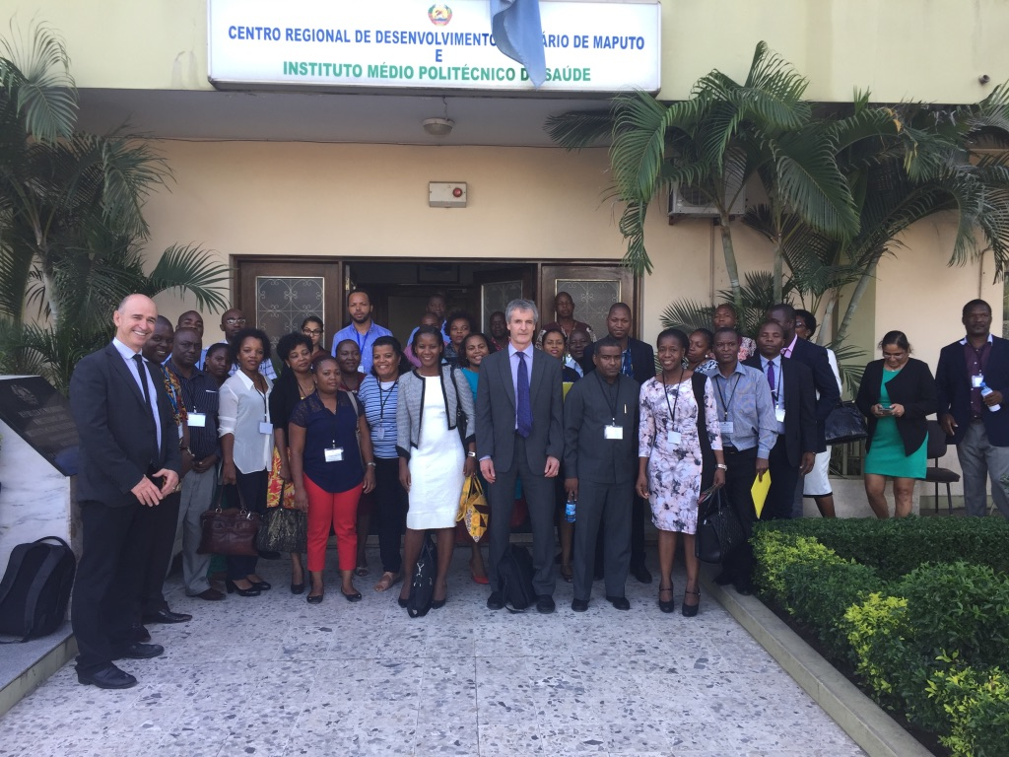

Slide 10
What was done so far?
Exchange visits (Sept 2014 to August 2015)
  Developed a programme of work in Ireland
  Confirmed in Mozambique
Ongoing communication
MISAU took charge (Feb 2016)
  First workshop Aug 2016
  Second workshop Nov 2016
  Third workshop Mar 2017
  Training of Trainers (ToT) August 2017
  November 2017 - Move to explore twining Hospitals

Slide 11
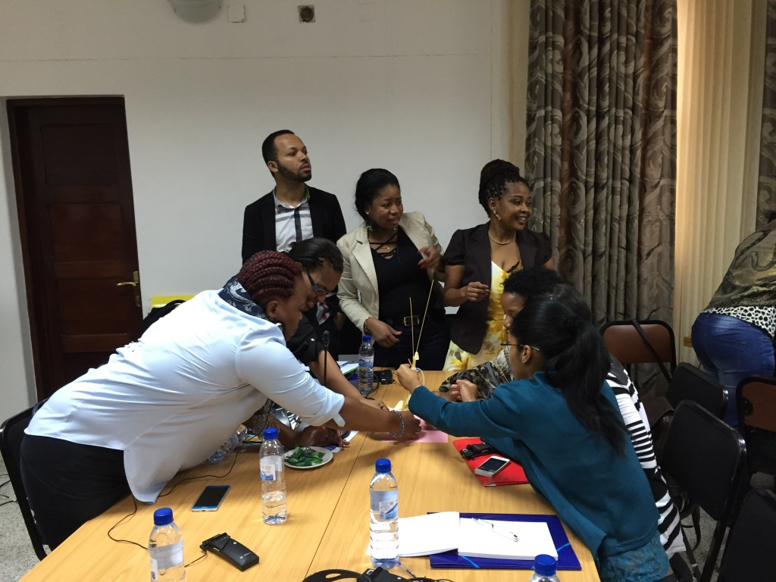

Slide 12
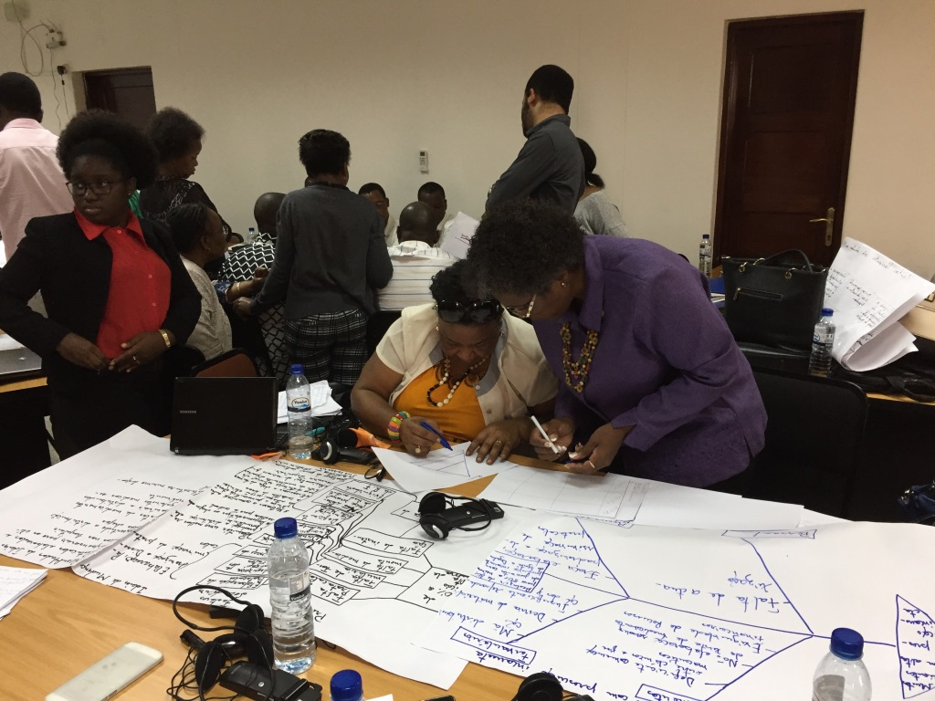

Slide 13
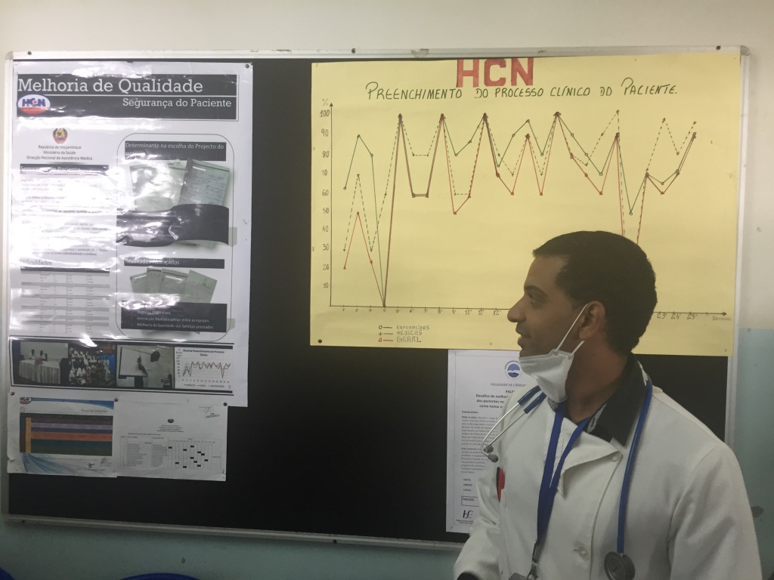
NAMPULA CENTRAL HOSPITAL

Slide 14
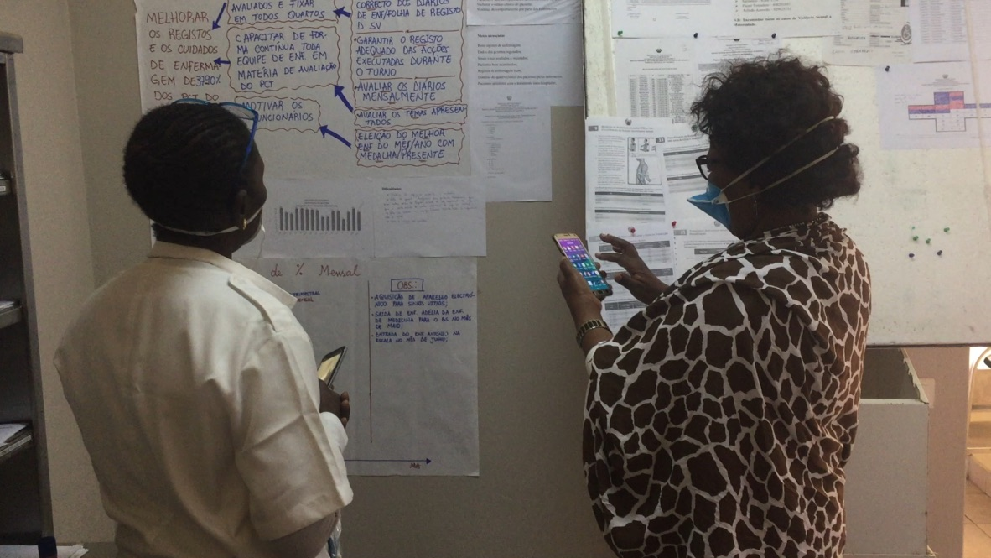
Manhica District Hospital

Slide 15
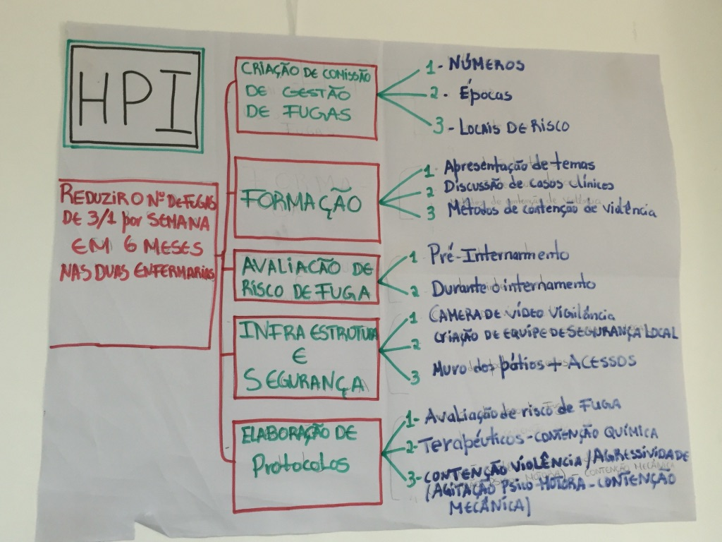

Slide 16
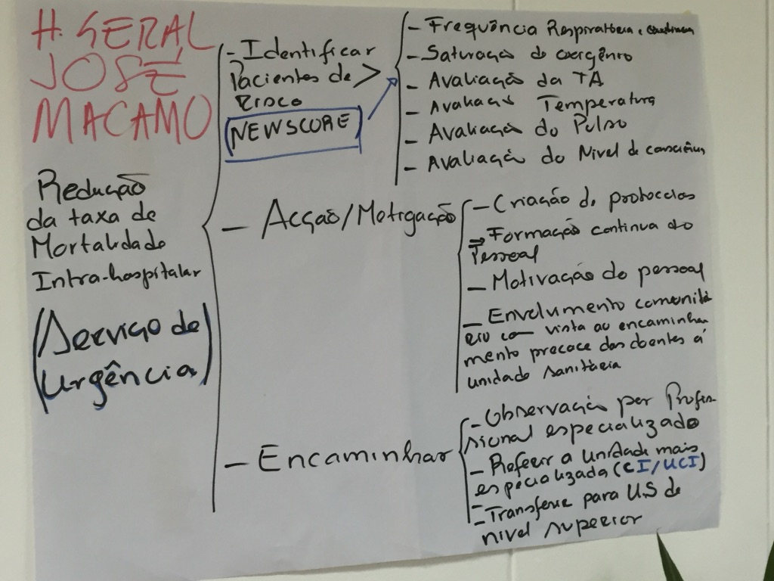

Slide 17
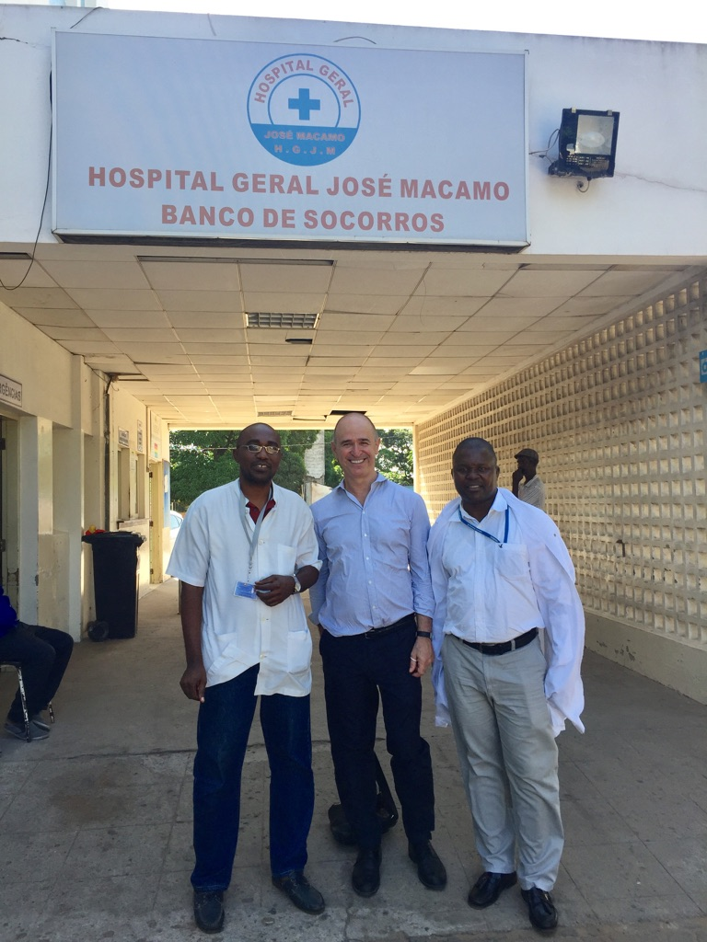

Slide 18
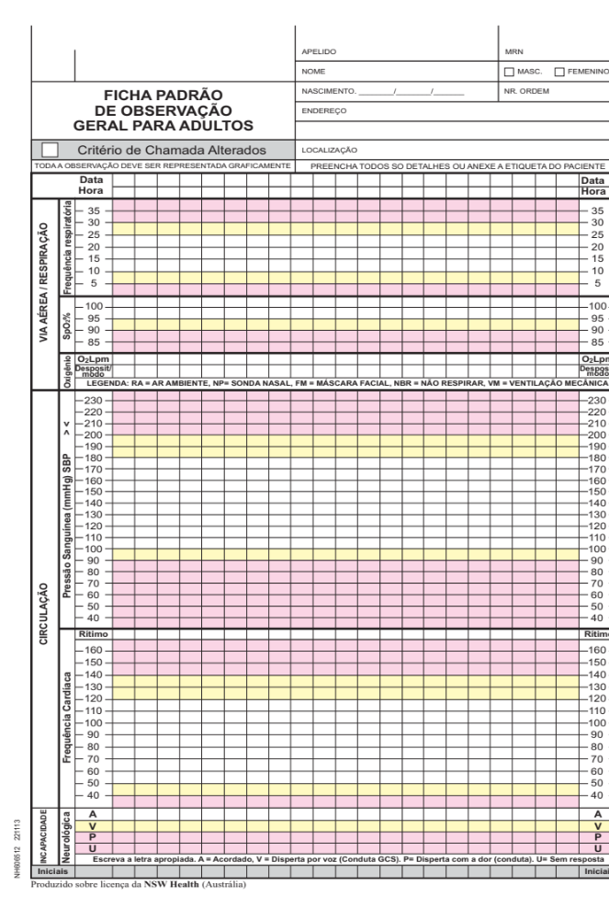
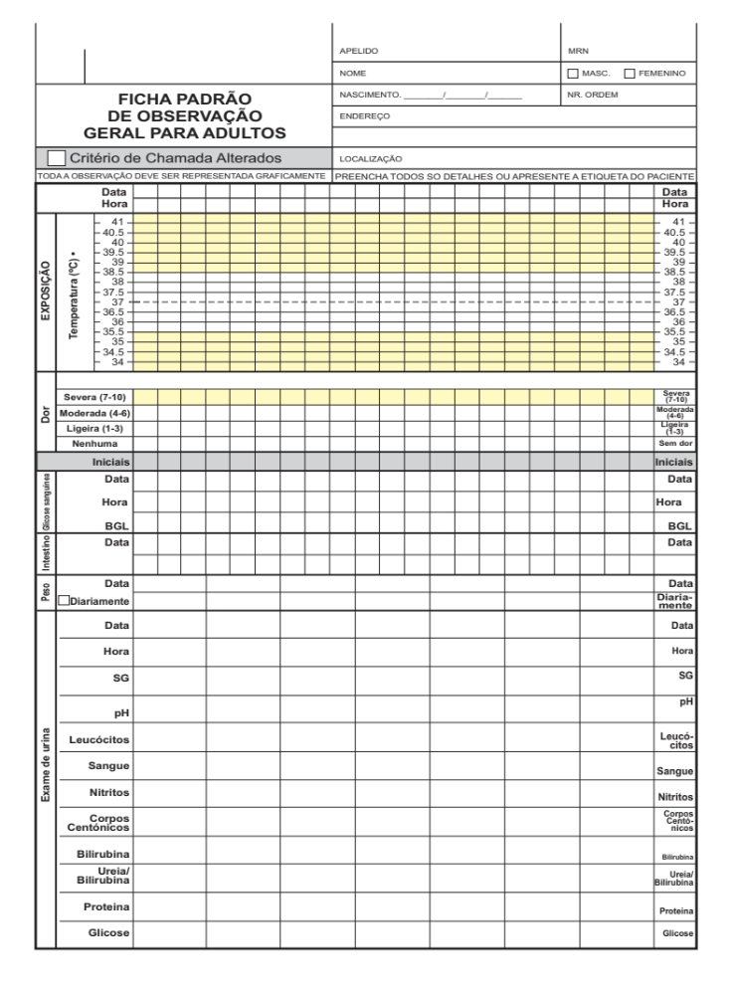

Slide 19
Has it worked?
Improvements in safety and quality of care:
  Reduced by half nr of death in the first 24h at Emergency Unit
  Reduced 40% of still births in Lichinga
  Reduced waiting times in Case of Matola, Mavalane…
  Improved record keeping - Case of Nampula
  Reduction in patients absconding from hospital
Staff morale improved at hospitals
Staff have acquired tools and skills to continue changing practices
BUT THIS HAS TO BE SUSTAINED. WE ARE ONLY AT BEGINNING OF THE JOURNEY

Slide 20
LICHINGA Provincial Hospital
Elevado numero de NM com foco positivo a entrada na maternidade 1 do HPL
Objectivo Principal:
Reduzir o numero de focos perdidos na sala de parto do Hospital Provincial de Lichinga de 24 para 3 nos próximos 3 meses (Relatório anual 2014/2015)

Slide 21
Lichinga Provincial Hospital NM c/ F+
2016 Before and 2017 after the implemtation

Slide 22
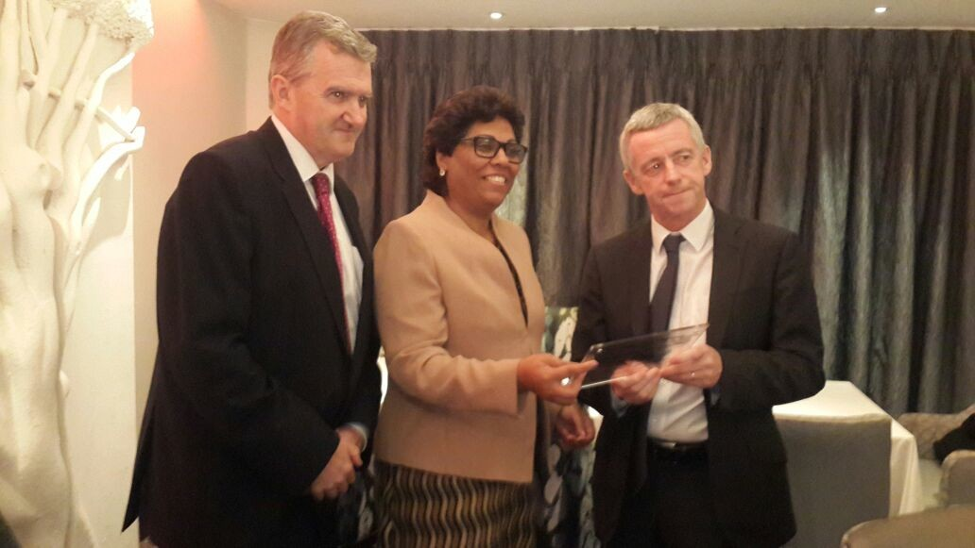
Why it has worked so far?

Slide 23
Key Ingredients:
Respect
Context
Adaptability
Sustainability from the start
Making it relevant & Commitment
Exchange and Communication
Each Partner Playing its Role effectively
About Peoples Lives
Aid and Beyond
Leadership

Slide 24
Why it has worked?
Political and technical commitment and leadership – national and local levels
Local ownership and empowerment by hospitals and MoH teams
Communication was key
Different partners playing essential roles
  Not just HSE and MoH; also Irish Aid, ISQUA, Aurum Institute
Local and HQ funding for implementation
Notes:
Ruairi de Burca
Good example of facilitating existing expertise

Slide 25
Future of Partnership
Developing sustainable capacity building in QI
  Training of trainers
  National framework for quality
  Ongoing engagement with local organisations, eg Aurum Institute, Jphiego,
New areas
  Medicines management / rational drug use
  Infection control in hospitals
  Training in public health medicine
  Twinning of hospitals

Slide 26
