Slide 1




East, Central and Southern African College of Obstetrics and Gynaecology
(ECSA-COG),
Program Co-Ordinator, Ms Judith Andrew
Institute of Obstetricians & Gynaecologists (IOG),
Royal College of Physicians in Ireland, RCPI
Méabh Ní Bhuinneáin,
ESTHER 7th Partnership Meeting 2022 | Working together to unlock potential | Sustainable Health Partnerships
Notes:
Good Afternoon, Evening, Morning – back from lunch
We, Judith ion-line from Arusha, and I are delighted to have this opportunity to talk a little today about the new partnership that is growing between two postgraduate Obs/Gynae training bodies - ECSACOG and the IOG-RCPI.
I’m delighted to attend another ESTHER Partnership Day – the little takeaway gems from these meetings have really helped over the years – data really counts, grab allies for leverage (NCD – Firth), learn the architecture of partnerships, use frontline knowledge, use the partnership improvement cycle. Next slide please.

Slide 2
Context
Global Surgery
  COSECSA
  CANECSA
  RCSI
  CAI
HSE Global Health Program
  Quality
  Global Health Education
  ESTHER and Irish Aid
Forum of Post-Graduate Training Bodies
  Global Health Team
ESTHER 7th Partnership Meeting 2022
Notes:
In this field, Postgraduate colleges and GH programs have been working in significant partnerships nationally and internationally.
Lead, coach, share, publish, support, influence and repeat – long-term committers.
Judith – ECSACOG Program Coordinator has prior experience with COSECSA, the offices are shared in the ECSA Health Community.

Slide 3
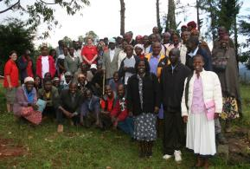
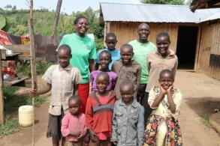
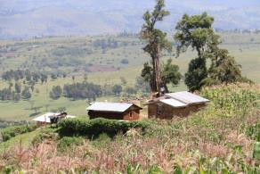


Community Health Strategy, Maternal Survival Program, Londiani-Mayo Hospital Link with Brighter Communities WW
12 IOG Fellows – Study Tour to Kenya
Healthy homestead
Healthy family
Healthy community
Notes:
Brighter Communities, a community development NGO in Kenya, that was facilitating the Mayo-Londiani Link, hosted a Study Tour DOVS- entry point for a number of Obstetricians and Gynaecologists from the IOG – Piggy-backed on Emergency Obstetrics and Newborn Care Education.
Their (BCW) entry was peer ed to reduce maternal-child transmission of HIV.
The Maternal Survival Program developed – community women and men, informal health care providers and the wider health system.
However good this method is for sensitsiing communities and increasing referrals, and training the non-surgeon staff, it remained a challenge to leverage specialist Surg/Anaes/Obs specialist appointments.
Over 10 years only one local doctor completed clinical specialist training (O/G ) and then was bonded to another MOH district. Opportunity to reflect on long-term training commitment.
Quite a few left for the private sector or NGO sector or Public/Population Health.
The link prioritiy areas are perinatal health (including BP and Diabetes), trauma care and NCDs.

Slide 4


Challenges in Global Obstetrics
& Gynaecology
ICPD 25 commitments Nairobi summit
  Zero preventable maternal mortality
  Zero sexual and gender-based violence and harmful practices
  Zero unmet need for family planning
Global Surgery Burden
  Workforce issues – HRH – Surgery-Anaesthesia-Obstetrics-Nursing
  Infrastructure, Supply, Leadership
  Silent burden of Gynaecology
    Menstrual Health – Menopause – Fertility – Cancer – Urogynae & Fistula
  Comprehensive Emergency O/G Care
ESTHER 7th Partnership Meeting 2022
Notes:
The global burden of surgical disease is estimated at 30%, disproportionately affecting the low and middle income countries3. Significant scale-up is required to meet surgical need – estimated at 5000 surgical procedures and 40 surgical, anaesthesia and obstetric providers per 100,000 population. Surgical services are an integral component of national health systems2.
One key provider in global surgery is the specialist obstetrician – a physician provider with advance life-saving surgical skills for pregnancy and birth. A key package in improving maternal survival is to scale-up capacity in comprehensive obstetric care which includes provision of safe timely surgery and blood treatment4. Health workforce expansion remains a barrier to scale-up in obstetric care provision5. Shortage of health professionals reduces the availability, accessibility and quality of care, especially in the lower resourced setting6
Good to hear from Anne Holmes, Irish Aid, this am that SRH and Rights is named as a priority –even in our own national response to covid, the issues in the humanitarian response to vulnerable groups in access/availability to SRH services was an initial problem.

Slide 5
Workforce Strengthening
Lancet commission recommends a minimum of 20 surgeons, anaesthetists and obstetricians per 100,000 population
Sub-Saharan African countries have the largest numbers of births per woman but some of lowest densities of midwives and obstetricians
Access to safe surgery and greater number of well-trained healthcare workers will reduce maternal morbidity and mortality
Mapping of OB/GYN workforce in ECSA region is required
Notes:
Generally expect 5000 procedures / 40 SAO providers / 100000 population
As improvements in Focused ANC 4 visits, Facility Birth, Essential Obstetric and Newborn Care evolves, there is greater demand for specialist care to lead comprehensive care and to address rising institutional mortality/morbidity.

Slide 6
The Specialist Obstetrician & Gynaecologist –
What Added Value?
Evidence Base:
Quality comprehensive obstetric care, leadership and training
Surgery provider and teacher
  How to, when to, when not to...
Sexual Reproductive Health, Values and Rights
Frontline knowledge to inform policy

Slide 7
Vision and Mission of ECSACOG
Objectives of
IOG
Vision
To be a reference body for reproductive, maternal, newborn health (RMNH) in the region of East, Central and Southern Africa and beyond
Mission
To be a lead organisation for clinical excellence in reproductive health in the region of East, Central and Southern Africa and beyond, and a platform for shared experiences and skills transfer
Current Member Countries
Rwanda, Tanzania, Zambia, Uganda, Ethiopia, Kenya, Mozambique, Zimbabwe, Malawi and South Sudan. Estab. 2017 in ECSA-HC
To represent Obstetrical and Gynaecological opinion in Ireland in a professional, advisory and administrative capacity.
To act as the advisory body in Ireland in matters relating to education, training, research and administration in the specialty of Obstetrics and Gynaecology, as well as to Governmental and statutory bodies in all matters pertaining to Obstetrics and Gynaecology.
Established 1968. Joined RCPI 1974.
Taking in 25-30 per year but graduating only 8-10?
Notes:
The collegial model is a lower cost model that other academic institutions and provides for life long learning.
It offers a wide geographical spread and rural provision at district hospital level that leads to improved retention.
Furthest behind first – If IA policy - focus on countries without master trainers,
First trainees in first accredited hospitals start this month!!!! Congrats to Judith and team for this landmark time – 3 countries – kenya, Rwanda, Zambia.

Slide 8
Institution Match
Common post-graduate training agenda
Interest in collaboration in:
Training the Trainer, Training Site Evaluation
ePortfolio and manual development for trainees and CPD
Examination/Assessment development
Secretariat support
ESTHER 7th Partnership Meeting 2022

Slide 9
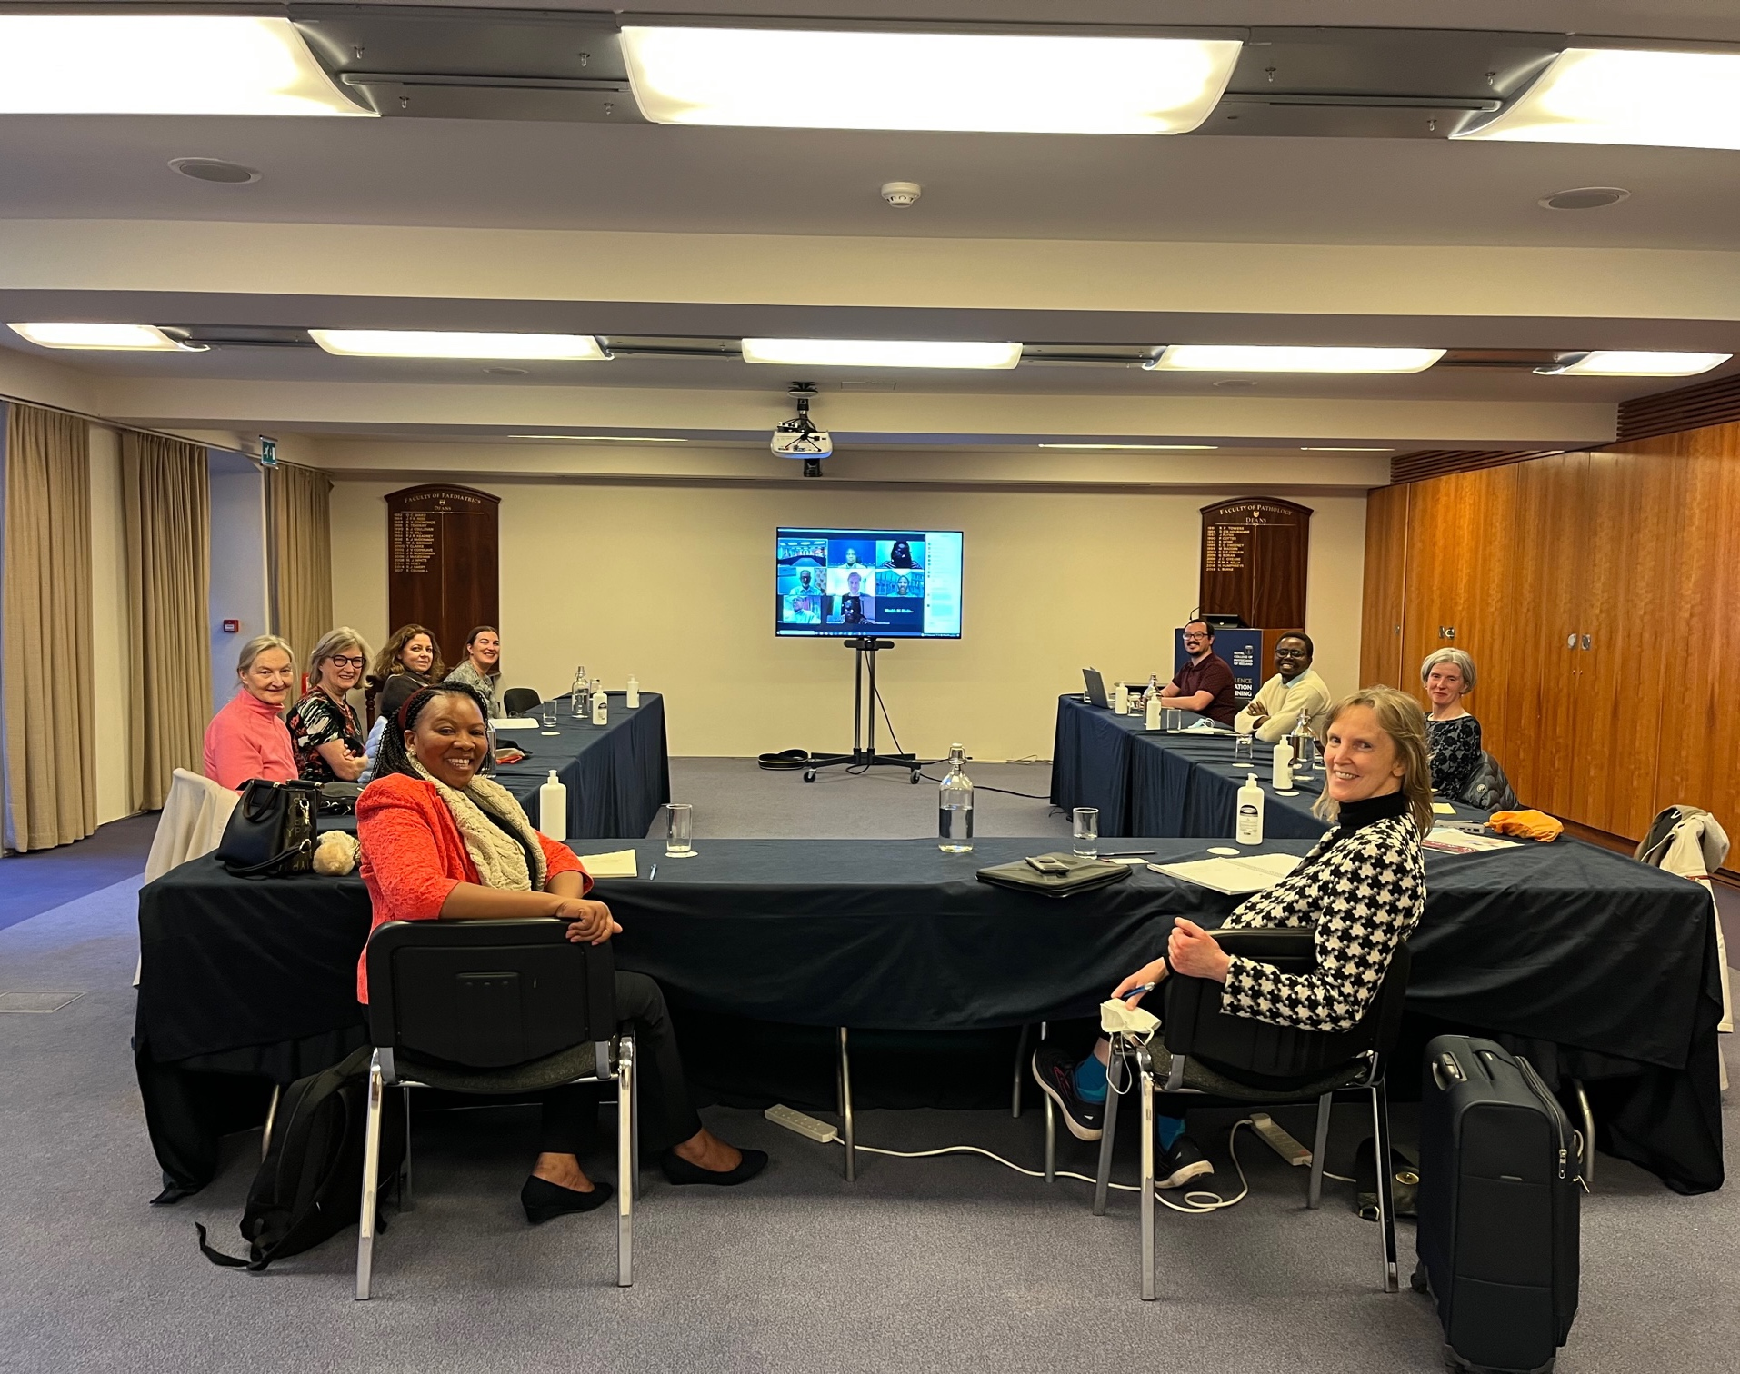
First Partner Meeting March 2022
RCPI & On-Line: Introduction & Vision Share
ESTHER 7th Partnership Meeting 2022

Slide 10
Partnership Establishment
MOU
ESTHER principles
Institutionalisation from inception
Change in Institute Chair and Governance structures
Change in ECSACOG President
Start-up grant
Start slow to go far….
ESTHER 7th Partnership Meeting 2022

Slide 11


Second Partner Meeting October 2022
Memorandum of Understanding
Kenya
Training Site Visit
Trainer Meeting
Trainee Meeting
Irish Embassy Visit
Community Visit BCW
Patient Experience
Zimbabwe
Scientific Meeting
Partner Meeting
Climate/Carbon Off-set.
ESTHER 7th Partnership Meeting 2022

Slide 12
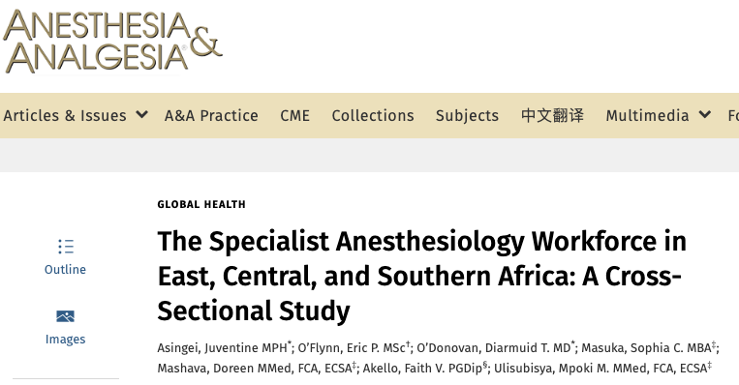
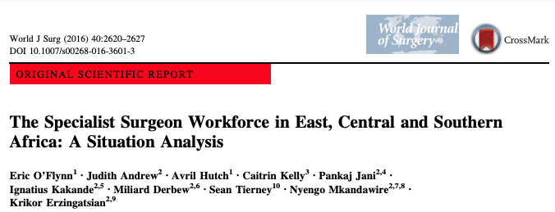
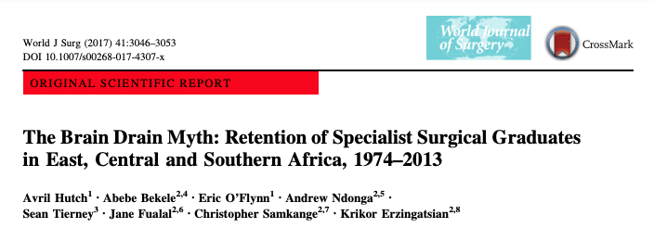
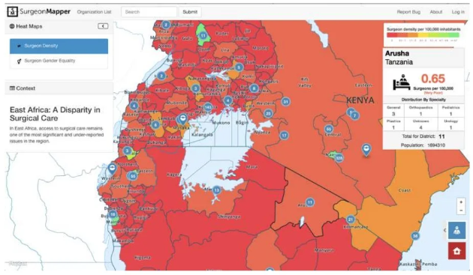
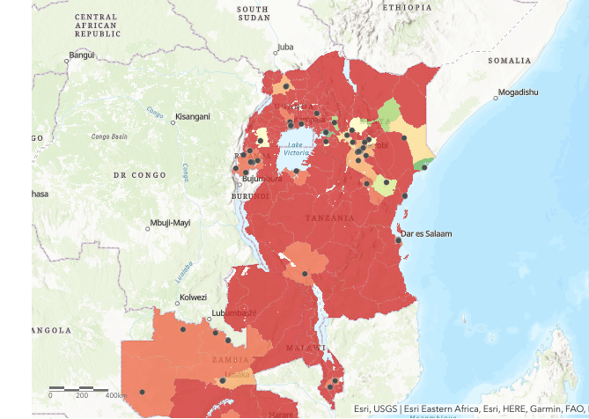
ECSA Workforce Analyses

Slide 13
Cycle of Work
eportfolio and trainer support
Stakeholder meetings
Country engagement
Research group established – Obstetric & Gynaecology Workforce study – baseline data for longitudinal measurement of impact. Meeting fortnightly.
Strategy – Goals – Outputs
ESTHER 7th Partnership Meeting 2022

Slide 14

Thank-you.
Asante sana to all our facilitators & enablers.
Acknowledgements:
    Judith Andrew, Prof Annettee Nakimuli, Prof Bellington Vwalika, Eric O’Flynn, Lucia Brocato, Laura Coe, Godfrey Sama Philipo, Chris Minja, Cliona Murphy, Sam Coulter-Smith, Carole Barry Kinsella, Mary Holohan, Una Fahy, Fiona Cullinane, Darragh Whelan (IOG), Sara Mohan (JOGS)
“Health is fundamentally a social and political choice rather than a personal choice”. WHO.
ESTHER 7th Partnership Meeting 2022

Slide 15
Additional Slides if time/questions

Slide 16
Global Health Twinning Partnerships for Improvement:
ECSA College of Obstetrics and Gynaecology and Institute of Obstetricians and Gynaecologists, RCPI
Obstetricians and Gynaecologists in the Global Surgery, Maternal, Newborn and Reproductive Health and Rights Systems
On behalf to the RCPI, we would welcome the opportunity to meet with members of the Irish Embassy in Nairobi to discuss reproductive health and rights in the ECSA region and our evolving partnership work.
This collaboration of two post-graduate training institutions is guided by:
1. UN Sustainable Development Goals:
  3&17: Health, Well-Being and Partnership;
  1,2,4,5: Poverty, Hunger, Education & Equality
2. Irish Aid Policy.
  Program countries of the ESCA Health Community ecsahc.org. Furthest behind first.
  Priority themes: Gender equality, Intersectoral support of girls & women in education, in economic development including agricultural and as peacemakers.
3. IOG and ECSA COG shared vision, mission, societal and post-graduate training roles.
4. Nested in and guided by the longstanding Irish Aid funded College of Surgeons collaboration – COSECSA & RCSI
5. A scale-up program from learnings in the Mayo-Londiani, Kenya Hospital Partnership (2009-to date), facilitated by Brighter Communities Worldwide.
Maternal health is a societal function, not a disease. It is a measure of the human right of the girl/woman to life, to freedom of choice, freedom from unsafe practices and to access quality health care.
Maternal Mortality Rate (MMR) is a barometer of the composite measure of the societal impact onall of the above – it is a measure of the health and human rights of a nation.
Sub-Saharan Africa has the largest burden of MMR in the world. This collaboration in Maternal, Newborn, Reproductive & Surgical Health, through the work of ECSA-COG within the region, seeks to address gender inequality through the strengthening of safe, respectful sexual and reproductive care in the partner countries.
 | RCPI – IOG and ECSACOG 2022

Slide 17
Briefing Notes for IOG Executive
Good Development / Aid Practice
Good Technical Assistance
Do no harm
Value for money
Contribution to sustainable development
Are Institutional Health Partnerships doing the right things?
What’s the additionality of partnership working?
Think about impact, reach, lasting benefit
ESTHER 7th Partnership Meeting 2022

Slide 18
How do we measure the quality
Use M&E tools
Adhere to ESTHER charter for Quality
Use THET Principles on Quality Partnership
Lasting effect – ESTHER EFFect Tool
ESTHER 7th Partnership Meeting 2022

